Slide 1



KF-SCIS: Learning from ABET
Trevor Cickovski, Interim Associate Director, Knight Foundation School of Computing and Information Sciences (KF-SCIS)
Nagarajan Prabakar, Undergraduate Program Director, KF-SCIS
2023
Assessment Conference

Slide 2
Trevor Brainstorming: Lesson #1
Stay on top of ABET, their outcomes, and their regulations
ABET had predefined outcomes that we were forced to follow for our degrees.
Indirect assessment will not work. Direct assessment of student outcomes must be done
The problem then became, the outcomes for our courses were not the same as the ones ABET had predefined.
We were forced to map our outcomes to theirs as best as we could (‘indirect’ assessment)
While the indirect assessment did get us past Deficiency into a Weakness, that Weakness could not be removed until we submitted a response and proved we could do direct assessment on our SPR23 courses

Slide 3
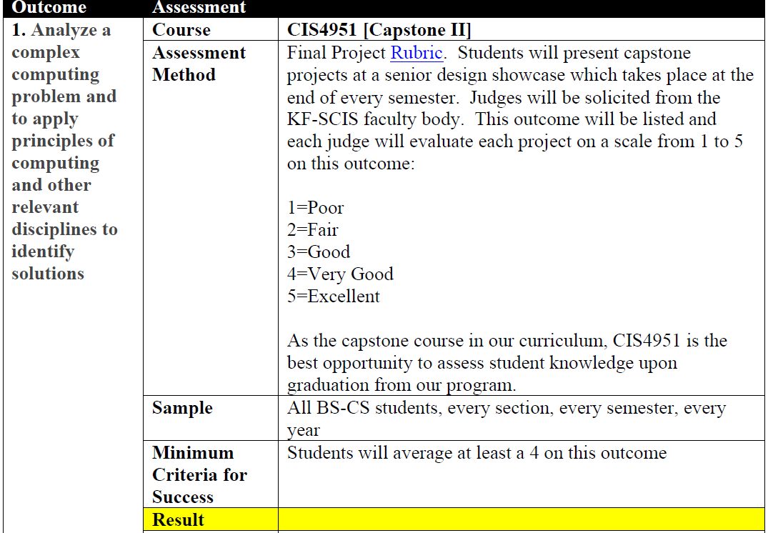
Trevor Brainstorming: Lesson #1
They want each metric directly assessed within a rubric, with specific courses, rubrics for each course, numbers of students, etc.

Slide 4
Trevor Brainstorming: Lesson #1
Note: Each course you assess will require at least one instructor to agree to a pretty substantial amount of work (data collection, plus they may have to learn the assessment process).
Advice: Do not over-assess (the PEVs told us this as well). (1) Use the minimum number of courses necessary to assess all outcomes across all your disciplines (2) Choose faculty who have done assessment in the past, if possible
New Rule This Year: SACS outcomes must match ABET. That is good news :)

Slide 5
Trevor Brainstorming: Lesson #2
The PEVs will know your curriculum, inside and out
Each degree program you assess will have one PEV devoted to its evaluation. Their sole responsibility is to research your degree program thoroughly, and ensure conformity with ABET standards. Do not be surprised if they point out very remote issues.
Example -> BS-CS requires 15 credits of mathematics under ABET. We fell one credit short, because one course in our Foundations Elective group (each student must take one) out of 10 was found not to have enough math for 1 credit. This went down as a Deficiency, which we now are writing a response to address.

Slide 6
Trevor Brainstorming: Lesson #2
Advice:
Required courses will matter significantly more than electives. Required courses will be taken by every student who graduates from your program. ABET can then count on every student being exposed to the material in these courses.
Rule of thumb: If it is possible for even one student to graduate with a degree without taking course X, you cannot tell ABET that your degree covers the course material of X (PEVs told us this, many ties).

Slide 7
Trevor Brainstorming: Lesson #2
Advice
Particularly for required courses – take seriously what you post online. Be sure your syllabi are up-to-date, contain appropriate numbers of hours (if you do this), have reasonably recent (or historically known) textbooks. Be sure your website(s) are fully accurate with degree requirements
Also check across the University – for example, FIU Online had a page advertising our online BS-IT degree. Two problems: (1) It had not been updated alongside our degree requirements, and (2) It had no link to KF-SCIS. The PEVs initially thought it was another college at FIU offering the same degree.

Slide 8
Trevor Brainstorming: Lesson #2
Advice:
Particularly for required courses – use favorable language in your syllabi. If ABET requires a topic to be covered, say that topic frequently in your syllabi or change the wording to say the same thing
Example: For our BS-CS, “project management” was desirable. We had many courses that involved students building software projects on teams, with students serving in leadership roles. Instead of saying “student leaders”, say “project managers”, can be a big difference (though it means pretty much the same thing).

Slide 9
Trevor Brainstorming: Lesson #3
Do not view ABET as a hurdle, but an opportunity.
As a result of these efforts:
The KF-SCIS curriculum has a more solid core, with two new courses added
Departmental materials are way more organized (we had no choice, but it was a great by-product)
Efforts are far more streamlined (including between ABET and SACS)
A concentrated set of faculty are assessing courses, taking assessment training, meeting, etc. - they are becoming more specialized, removing the burden from others
We hired an assessment coordinator to manage these efforts, and have a faculty member who will serve as a PEV in the future (keeping us more in the know)
And in my opinion, bottom line, all of our degree programs have improved

Slide 10
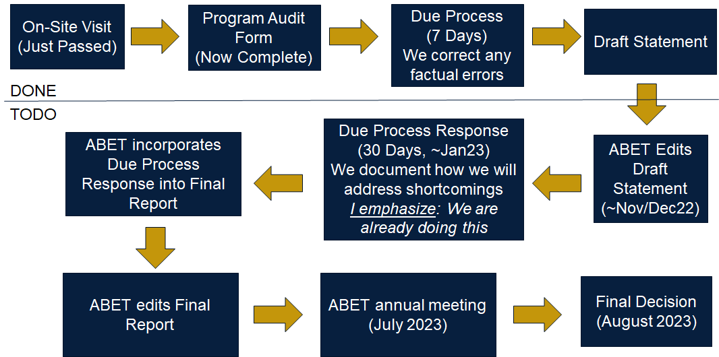
Our Timeline

Slide 11
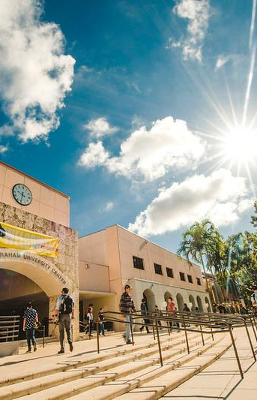
Intro
Presented by

Slide 12

Agenda
ABC
123
XYZ
789

