Slide 1
KFSCIS Town Hall: Curriculum Changes, Computer Science (CS) and Cybersecurity (CY)
Trevor Cickovski, Associate Director
Nagarajan Prabakar, Undergraduate Program Director
Patricia McDermott-Wells, Undergraduate Program Committee (UPC) Chair
Kianoosh Boroojeni, UPC Computer Science Sub-Committee Chair
Ahmad Waqas, UPC Cybersecurity Sub-Committee Chair
Ruth Suarez, Academic Advising Manager

Slide 2
Motivation For Changes
Ubiquity of AI
  Rapid adoption of AI-assisted tools in software development, and cyber offense/defense
Shifts in Industry Expectations
  CS: Programming proficiency is no longer enough
    Computational thinking, systems understanding, ability to critically evaluate AI-generated artifacts
  CY: Increased demand for specific skills
    Scripting, data-driven techniques, automation, cloud security, incident response, risk governance
    Threats are becoming more diversified
FIU Institutional Practices
  Deliberate integration of AI
  Maintain rigor, ethical responsibility, accreditation

Slide 3
Implications for Students
Students admitted Spring 2025 and prior:
  Will be given a choice between keeping the old requirements and switching to the new requirements
  From this point forward, KFSCIS curriculum will be offered with the new requirements in the mind
    Some courses under the old requirements will not longer be offered
    KFSCIS has developed replacements that can be used to meet them
    We will discuss these in this talk
Students admitted Summer 2025 and after:
  Will be advised under the new requirements

Slide 4
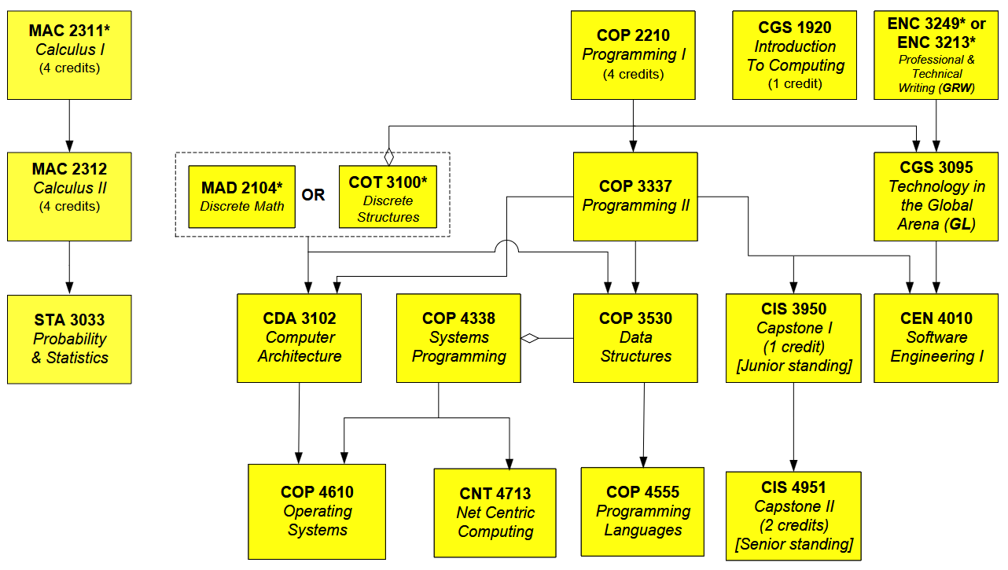
CS Change #1

Slide 5
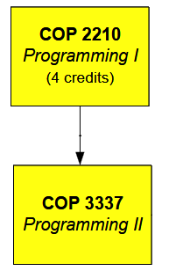
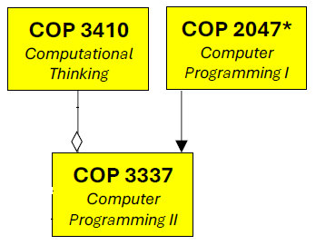
CS Change #1
Java
Python
Java
Java
Two-course Java sequence replaced with a two-course (Python, Java) sequence, plus a course entirely devoted to computational thinking

Slide 6
CS Change #1: Rationale
Java
Python
Java
Java
Language diversity
Many statistics mark Python as (by far) the most popular language for industry
Lower syntactic barrier for beginners
  Downside: A lot of the “computational thought processes” are abstracted away
    And today, these are more important than ever because of GenAI
    We devote an entire course to them, and make a co-req of Programming II

Slide 7
CS Change #1: Implications
Java
Python
Java
Java
COP2210 will no longer be offered
Students under old requirements
  If you have taken COP2210: Will be granted permission to take COP3337
  If you have not taken COP2210: You must take COP2047 and COP3410
    We will allow COP3410 to count as an elective, so you do not go into excess credit

Slide 8
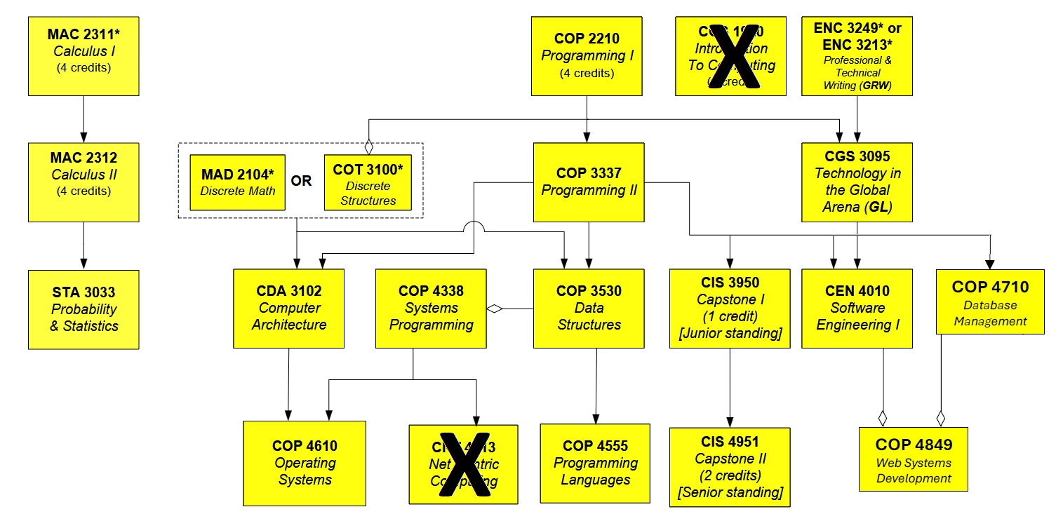
CS Change #2

Slide 9
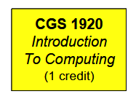
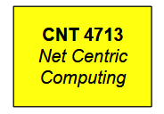
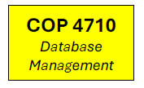
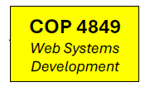
CS Change #2: Rationale
There is now a Career Readiness group of electives, that provides what CGS1920 did before (and beyond)
The emphasis of CNT4713: networking fundamentals, security, applications, mobile/wireless computing
  We will continue to offer this as an elective (Systems Group)
The emphasis of COP4849: client-server communication, applied cryptography, full-stack design, cloud development, responsible GenAI use
  Designed to reflect how modern software systems are built, deployed, maintained
The addition of COP4710: databases underpin nearly every contemporary application domain

Slide 10
CS Change #2: Implications
CNT4713 will still be offered (as an elective, as mentioned)
CGS1920 will no longer be offered
  This impacts other degrees as well so we will discuss at the end, but just note for the moment

Slide 11
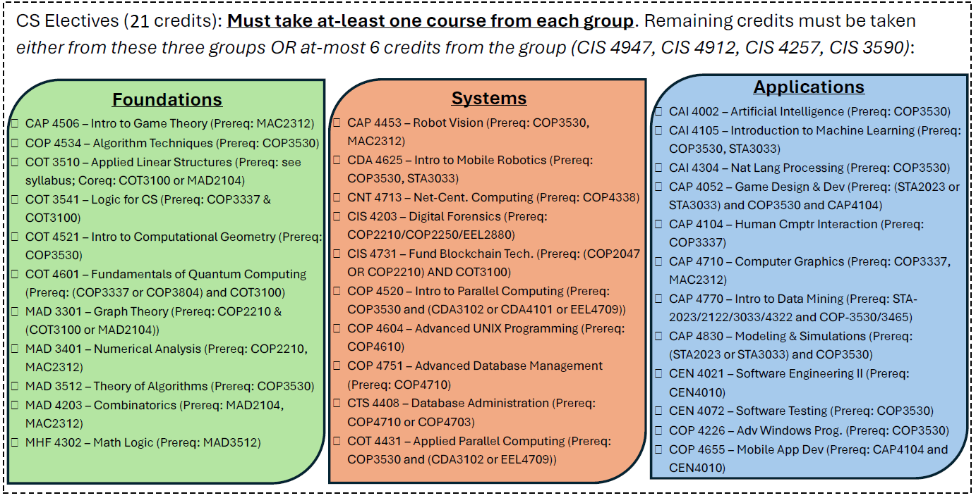
CS Change #3: Electives
Core has grown by 5 credits
  Courses Added: COP2047, COP3410, COP4710, COP4849 (+12 credits)
  Courses Removed: COP2210, CGS1920, CNT4713 (-7 credits)
We are shrinking the elective requirement by 9 credits (three courses)
12
Foundations

Slide 12
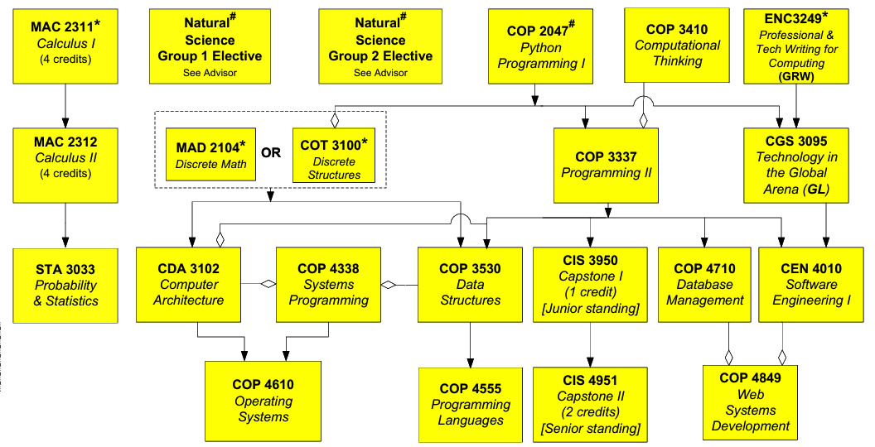
Other (small) changes
  COP3337 now a co- (not a pre-) requisite of CDA3102
  CDA3102 now a co-requisite of COP4338
  COP4710 and CEN4010 are co-requisites of new course (COP4849)

Slide 13
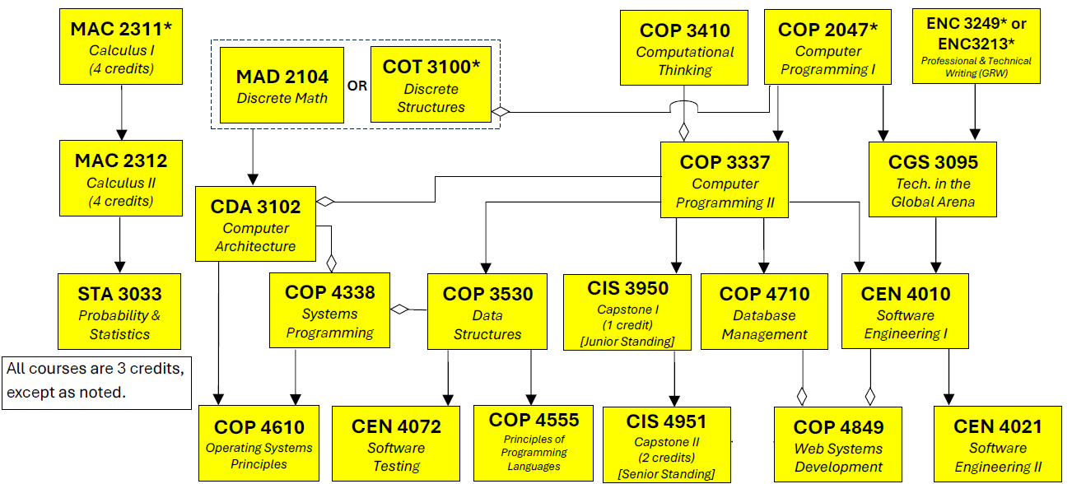
BS-CS (Software Design and Development Track) has all of the same changes
  CEN4021 and CEN4072 are still required (as they were before)
  Elective requirement shrinks from 15 credits to 6 credits (same 9-credit reduction, same expectation of taking one from Foundations)

Slide 14
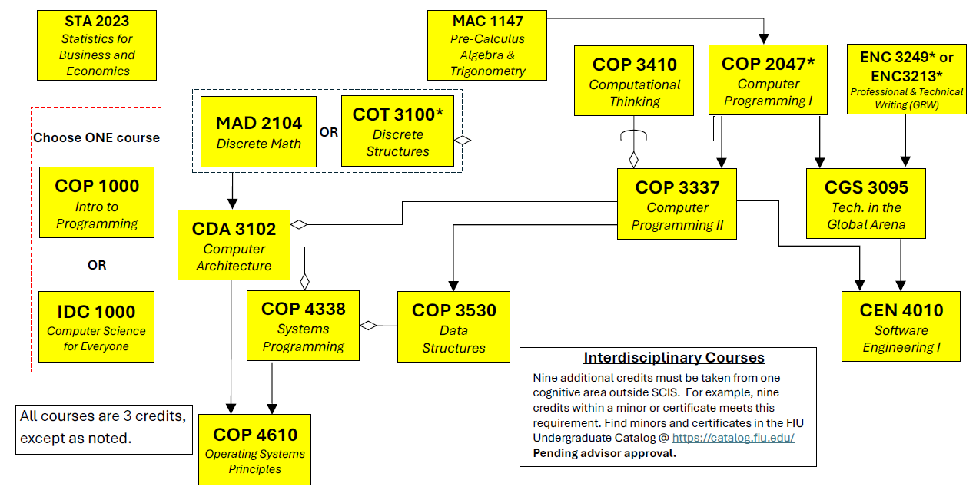
BA in Computer Science
  All of the same changes were implemented, with the exception of the addition of COP4710 (Databases) and COP4849 (Web Development)
    Only two courses added (COP2047 and COP3410), +6 credits
    One course dropped (COP2210), -4 credits (Net: +2)
    Elective requirement was not lowered as much (6 credits from 18 to 12), and you still need to take one from each group

Slide 15
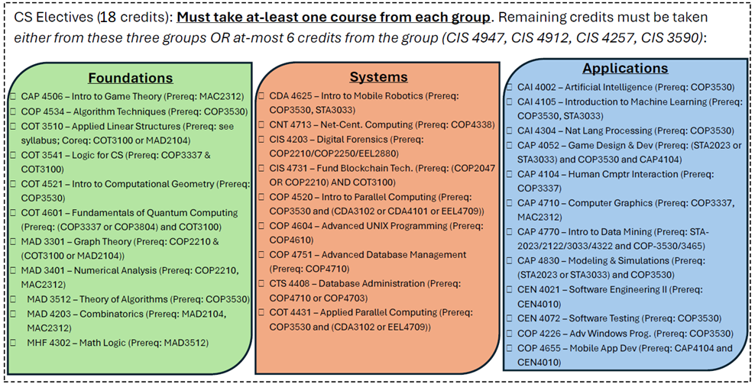
BA in Computer Science: Elective Requirements
12

Slide 16
CS Changes: Summary
Change | BS-CS | BS-CS SDD | BA-CS
Intro Programming Sequence (COP2210/COP3337 -> COP2047/COP3410+COP3337) | Yes | Yes | Yes
Database and Web Requirement (COP4710 and COP4849) | Yes | Yes | No
Net-Centric Computing Removal (CNT4713) | Yes | Yes | No
Intro to Computing Field Removal (CGS1920) | Yes | Yes | Yes
Change | BS-CS | BS-CS SDD | BA-CS
Elective Reduction | 21 credits to 12 One from Found | 15 credits to 6 One from Found | 18 credits to 12 One from each group
Pause here. Any questions?

Slide 17
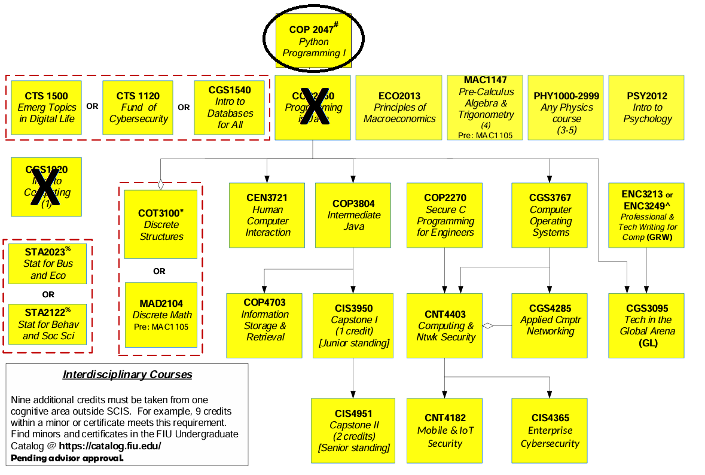
CY Change #1
Rationale for these changes is same as CS
  COP2250 and CGS1920 will both be discontinued

Slide 18
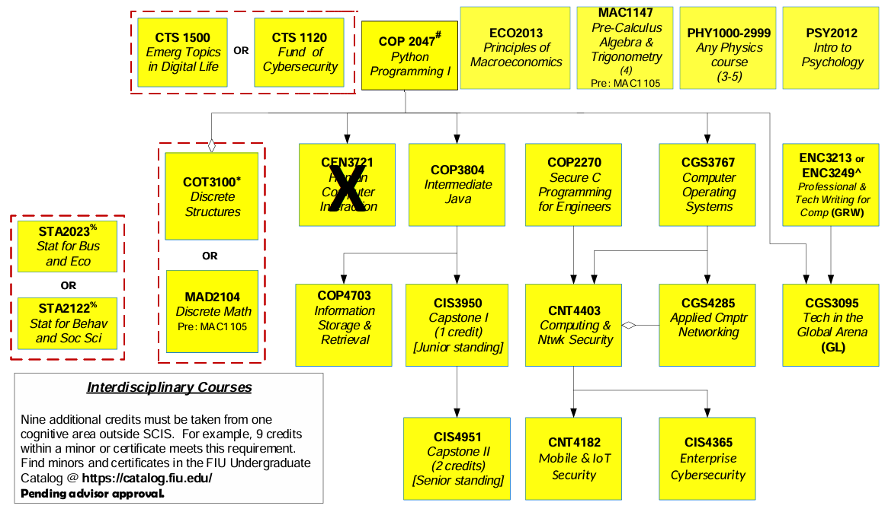

CY
Change
#2
CEN3721 (HCI) will be replaced by CIS4203 (Digital Forensics)
Rationale: Contemporary cybersecurity requires an understanding of forensics across a variety of domains (provided in CIS4203)

Slide 19
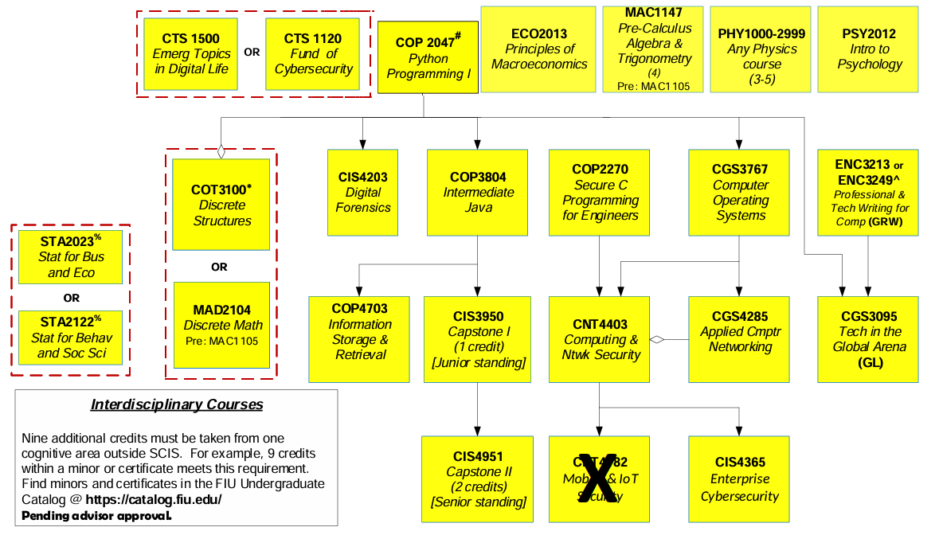
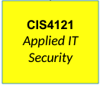
CY
Change
#3
CNT4182 will be replaced by a new course (CIS4121, Applied IT Security)
  Course will provide: enterprise security principles, network/perimeter defenses, incident management, IAM, secure coding, vulnerability management, automation
  CNT4182 can be taken as an elective (to come)

Slide 20
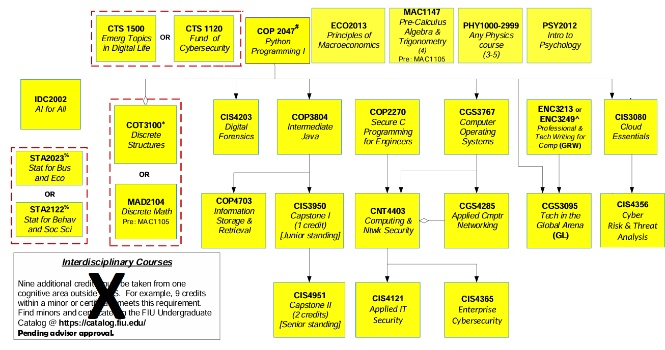
CY
Change
#4
Nine interdisciplinary credits replaced by three courses (3 credits, each providing important background for CY)
  AI, Cloud, and Risk/Threat Analysis

Slide 21
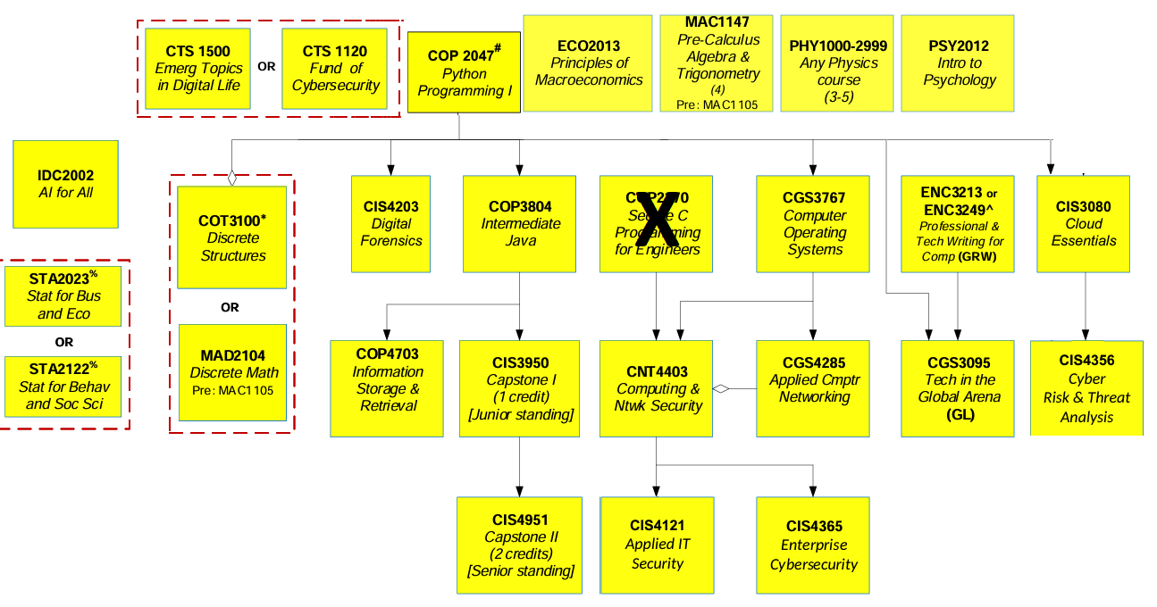
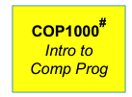
CY
Change
#5
COP2270 (Secure C Prog) replaced by COP1000 (Intro to Comp Prog)
  Our research and industry collaborations indicated an increased need for scripting, above compiled languages
  Implication: COP2270 will no longer be offered

Slide 22
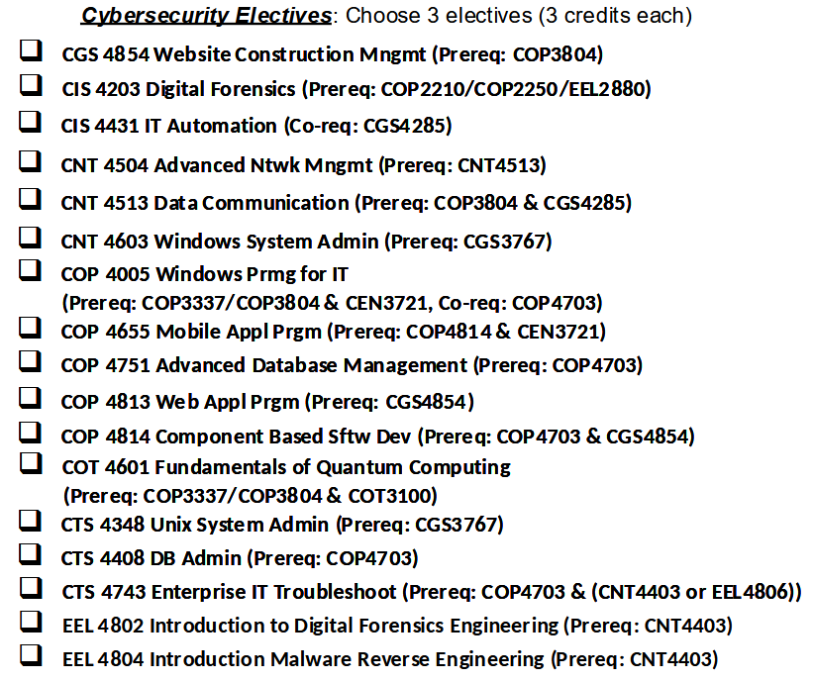
CY Electives
2
List has been reduced and curated
Also two new ones added:
CNT4182 (Mobile/IoT Security, used to be a req.)
CIS4731 (Blockchain)

Slide 23
CY Changes: Summary
Migration of Programming I from Java (COP2250) to Python (COP2047)
HCI (CEN3721) replaced by Digital Forensics (CIS4203)
Mobile/IoT Security (CNT4182) replaced by Applied IT Security (CIS4121)
  CNT4182 can still be taken as an elective
Three courses added – AI4All (IDC2002), Cloud Essentials (CIS3080) and Cyber Risk/Threat Analysis (CIS4356)
  Replace the nine-credit interdisciplinary requirement
Secure C Programming (COP2270) replaced by Intro to Comp Prog (COP1000)
Elective requirement reduced by one course and the list has been curated
Pause here. Any questions

Slide 24
Discontinued Courses
Our latest revisions to BS-CS and BS-CY resulted in several courses being completely removed from our curriculum
  CGS1540 (Intro to Databases)
  CGS1920 (Intro to Field of Computing)
  COP2210 (Programming I, CS)
  COP2250 (Programming I, CY)
  COP2270 (Secure C)
Big question:
  I have been admitted prior to Summer 2025 and want to stay with the old requirements, but courses I need will no longer be offered. What do I do?

Slide 25
Replacement Courses
Most of the discontinued courses have a direct replacement in the degree program
KFSCIS will count the replacement course as satisfying the requirement of the course that was discontinued.
Course | Degrees | Replacement
CGS1540 | BS-CY | CTS1500 or CTS1120
CGS1920 | BA-CS | COP1000 or IDC1000
COP2210 | BS-CS | COP2047
COP2250 | BS-CY | COP2047
COP2270 | BS-CY | COP1000

Slide 26
One Slight Exception: CGS1920
Although CGS1920 had alternatives in BA-CS, it did not in BS-CS and BS-CY
KFSCIS will waive the requirement of CGS1920 (one credit) for BS-CS and BS-CY students who have not taken the course and wish to remain under the old requirements
Course | Degrees | Replacement
CGS1920 | BS-CY | None
CGS1920 | BS-CS | None

Slide 27
Questions
Open the floor
Contact information
  Trevor Cickovski (tcickovs@fiu.edu)
  Ruth Suarez (rusuarez@fiu.edu)

