Slide 1
Introduction to IT Automation
By
Masoud Sadjadi
Jan.6, 2009

Slide 2
Motivation
Computer systems are becoming pervasive
They are part of our everyday life & business
Cost of dedicate in-house IT managers is high
They may be idle for most of the time
They may not be as effective in the time of crisis
Solution
Out-sourcing the IT to IT management companies
IT automation

Slide 3
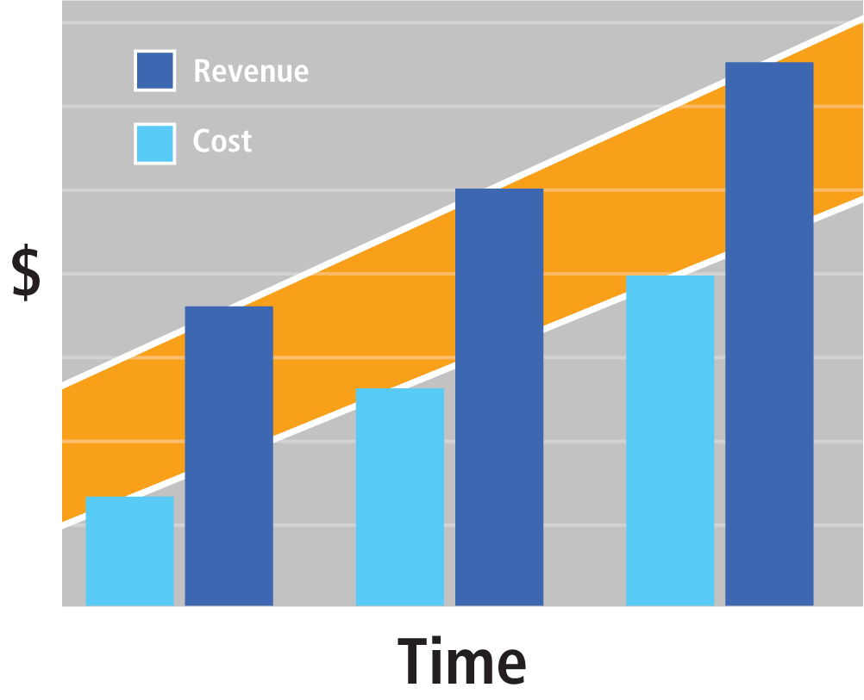
Why It automation?
More staff increase revenue and costs, making it impossible to get ahead.

Slide 4
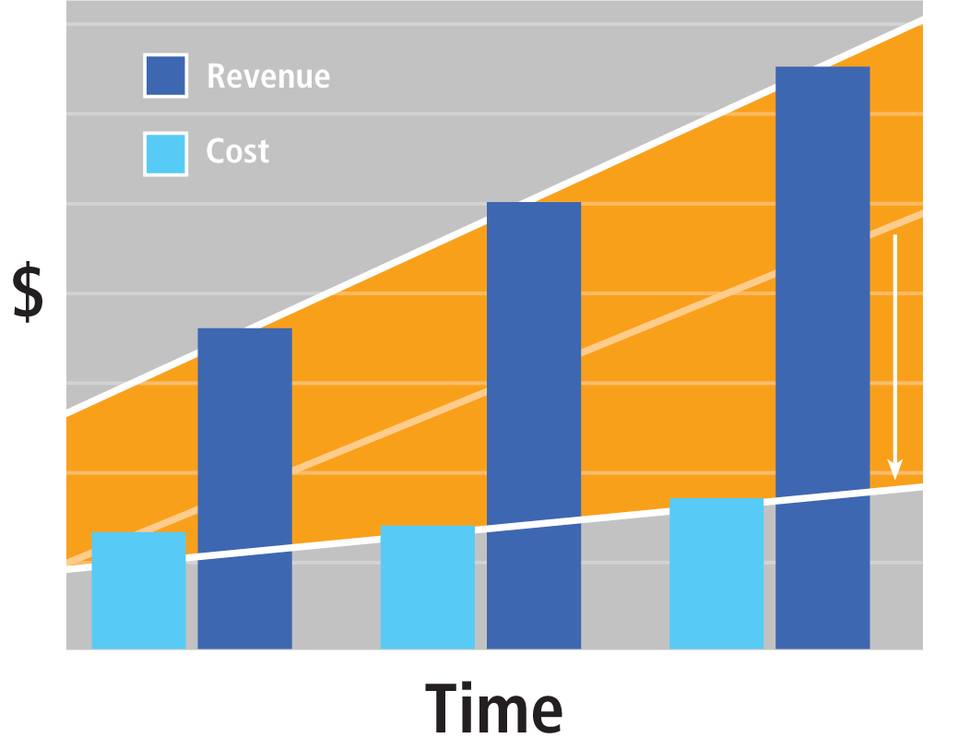
Scale with IT Automation
IT Automation allows service providers to keep costs the same while increasing revenue.

Slide 7
Why Transition Now?
According to Gartner (January 3rd, 2005)
“the fastest growing part of the IT Management Market is the Remote Operation and Management of Networks and IT Infrastructure”
“the Remote Monitoring and Management market is expected to grow at a compound annual growth rate of 36 percent through 2008”.

Slide 8
Why Transition Now? (cont.)
Rising acceptance of the paradigm shift to Proactive Service Delivery, the traditional “break-fix” model will become increasingly less appealing to the end-user Client.
Commoditization of these Services is inevitable, and price wars will follow soon afterwards.
The Guide to a Successful Managed Services Practice by Erick Simpson

Slide 9
The Business Valuation
The key to maximizing the value of an organization is in maximizing consistent Earnings over time.
Characteristics of break-fix service
Working long hours
Reacting to clients needs
Never have time to take the time off
Does NOT provide a consistent earning over time!
The Guide to a Successful Managed Services Practice by Erick Simpson

Slide 10
The Business Valuation (cont.)
But an Annuity-Based Managed Services model easily allows you the ability to forecast Earnings.
Industry statistics reflect that the value of an IT company employing
the traditional reactive “break-fix” model may be less than 1x its Earnings.
the manage services model can be as high as a 10x Earnings Valuation.
Note: Earnings, not Gross Revenue!
The Guide to a Successful Managed Services Practice by Erick Simpson

Slide 11
The Business Valuation (cont.)
There are many other factors to be considered for valuation of a company.
The key is that a buyer would look at the projected earning and not much to the history of your earning.
A great website to visit to begin learning about business valuation is Score’s business valuation page:
http://www.score.org/article_business_valuation_101.html
The Guide to a Successful Managed Services Practice by Erick Simpson

Slide 12
Exit Strategy
Every Business Owner needs to be clear on his or her Exit Strategy, which drives their Business and Marketing Plans.
For example, if you want to have the option to sell the company in 5 years for a price of $5 million, then with reverse projection, you need to reach to $83,333.
Target Amount ÷ Desired Earnings Valuation ÷ 12 = Monthly Earnings
It is not impossible to get there and do even better! ;)
The Guide to a Successful Managed Services Practice by Erick Simpson

Slide 13
Agenda
Background
Defining Managed Services
New Trends
IT Automation Tools
Summary

Slide 14
Traditional SMB IT Service
Traditionally SMB IT service providers adopted a reactive service delivery, called the “break & fix” and “time & material” business model.
Trades time for money
Generates immediate income needs
Does not scale
Needs heavy on site services by favorite technicians
The amount of billing relates on the site presence
Limits technician utilization
Requires delivery of services first, then billing
The Guide to a Successful Managed Services Practice by Erick Simpson

Slide 15
Managed Service Practice
SMB IT service providers need to transition to an annuity based, proactive, managed IT services delivery business model
Proactive nature, so billing occurs in advance, no invoice haggling
Increasing revenue (triple) without adding more staff
Preventing fire instead of fighting it
Recurring revenue that continues to grow
Ease in projecting revenue and allocating resources
Increasing value of company
Possibility of business loans and credit lines
Possibility of selling other solutions when the network in quiet
The Guide to a Successful Managed Services Practice by Erick Simpson

Slide 16
Transition Challenges
You become comfortable with what you do
You do not have time for change
You may be scared of loosing your clients
You may not trust the new model
Migrating existing clients is not easy
They are happy with what they have
You are your worst enemy as you have been providing a great service to them with the traditional break-fix model!
The Guide to a Successful Managed Services Practice by Erick Simpson

Slide 17
Agenda
Background
Defining Managed Services
New Trends
IT Automation Tools
Summary

Slide 18
Managed Services
Definition
Benefits to You
Benefits to Your Clients
Managed Services Offerings
Network Monitoring & Management
Help Desk
Vendor Management

Slide 19
Managed Services?
Any defined set of proactive services that are remotely delivered and prepaid for on a recurring basis.
Any services
HW, SW, HaaS, SaaS, DaaS, XaaS.
Proactive services
Prevent, less repair, less req. for the favorite technician
Remotely delivered
Less travel (80%), more labor utilization, more profit
Recurring basis
Increasing the value of the company
Continue to grow exponentially
The Guide to a Successful Managed Services Practice by Erick Simpson

Slide 20
Benefits to You
Annuity based revenue model
Long-term predictable revenue growth
No feast-famine cycles
Bill independently of any specific technician
No trade of time for money
Do much more with less; do much more remotely and proactively with less travel
No invoice haggling
Sell solutions much easier
Increase valuation
The Guide to a Successful Managed Services Practice by Erick Simpson

Slide 21
Benefits to Your Clients
Increase in the operational efficiency
Decrease in the operating cost
Cost effectively gain in access to enterprise-level IT support
Minimized down time
Focus on running their business, not their vendors
Piece of mind based on 24x7x365 monitoring service
The Guide to a Successful Managed Services Practice by Erick Simpson

Slide 22
Managed Services Offerings
Network Monitoring & Management
Providing Proactive Alerting of problems
Working 24x7x365; no sick day! ;)
Help Desk
Providing a Well-trained Staff, a solid SLA, and an Effective Escalation Process
Inefficient help desk results in losing your clients
Vendor Management
You can manage the Client’s Vendors.
Maybe even all of them!
The Guide to a Successful Managed Services Practice by Erick Simpson

Slide 23
1. Network Monitoring & Management
Monitoring Critical Services and other Network Devices such as Printers, Routers and Firewalls (using events such as WMI, SNMP and Syslogs)
Example Monitoring Tools and Services
Kaseya, Level Platforms, N-Able, Nagios, Silverback, Zenith Infotech, and others
Each has pros and cons
The Guide to a Successful Managed Services Practice by Erick Simpson

Slide 24
Characteristics of a Good Network Monitoring Tools
WMI, Syslog, SNMP Monitoring and Outputs Detailed Logging
Alerting: Email/Text Page/Pager; Has Configurable Alerts; Supports Escalation
Provides Meaningful Reporting
Multiple Operating Systems; Multiple Types of Hardware: PC’s/Servers/Routers/Switches/Firewalls/Printers
Critical Server Functions: Exchange/SQL/IIS/SharePoint/Linux/Novell
Multiple 3rd-Party Software Monitoring
Patch Management
Easily Integrates With Help Desk Systems
Remote Control of Monitored Devices
Is Affordable – Able to Monitor Numerous Devices Cost-Effectively
Is easy to Install, Deploy, Use and Maintain
Has excellent Vendor Support – and during the hours that your organization operates
The Guide to a Successful Managed Services Practice by Erick Simpson

Slide 25
What should be monitored?
Memory Utilization, Available Memory, Utilized Disk Space, Available Disk Space, CPU Load, Utilized Paging File, Available Paging File, Print Spooler Service, Printing Event, DHCP Service and Events, IIS Service and Events, DNS Service and Event, RRAS Services and Event, Terminal Services and Events, SQL Services and Events, Informational Security Events, Critical Security Events, Informational System Events, Critical System Events, Uninterruptible Power Supply Events, and Backup Events.

Slide 26
Automating Common IT Tasks
Auditing
Monitoring
Patch Management
Backup
Endpoint Security
User State Management
Help Desk

Slide 27
Managed Services Offerings
Network Monitoring
Providing Proactive Alerting of problems
Working 24x7x365; no sick day! ;)
Help Desk
Providing a Well-trained Staff, a solid SLA, and an Effective Escalation Process
Inefficient help desk results in losing your clients
Vendor Management
You manage the Client’s Vendors.
Maybe all of them!
The Guide to a Successful Managed Services Practice by Erick Simpson

Slide 28
2. Help Desk
You should offer a Remote Help Desk with an Unlimited Remote Support between the hours of 8am and 5pm Monday through Friday, across 4 Time Zones to your Clients, as well as your Managed Services Partners’ Clients, with all Services included in their monthly fee.
Clients appreciate being able to budget their IT costs for the entire year, knowing that there will be no unreasonable fluctuations.
The Guide to a Successful Managed Services Practice by Erick Simpson

Slide 29
Help Desk Offerings
Unlimited Remote, Onsite and Lab/Bench Time Support 8am-5pm M-F
Some Specific Limitations
for SW that you are not yet familiar with.
Phone Support
Remote Desktop Control
5pm-9pm Billable @ 1.5x
All Other Times Billable @ 2x
Server Disaster Recovery Included as Needed
Sample Agreement
The Guide to a Successful Managed Services Practice by Erick Simpson

Slide 30
Limiting the On Site Visits
Only go on site when there is a physical HW failure or other extra ordinary reason
Including all Onsite Visits and Lab/Bench Time in your Service Agreements does not necessarily required to go onsite any more often than you would otherwise.
This is a tremendous psychological Sales tool, as the Client loves the idea that their monthly fee will not fluctuate, no matter how and where Services are delivered.
The Guide to a Successful Managed Services Practice by Erick Simpson

Slide 31
Limiting the On-Site Visits (cont.)
How about Disaster Recovery?
If the Client’s Server is being properly maintained, and Proactively Monitored, you are not likely to see a failure requiring a complete Recovery.
So the “All-You-Can Eat” Remote, Onsite and Lab/Bench Time Help Desk Service, with Server Disaster Recovery included in your Flat-Fee Service Agreements, provides you with a tremendously powerful Unique Selling Proposition with Prospective Clients.
The Guide to a Successful Managed Services Practice by Erick Simpson

Slide 32
Limiting the On-Site Visits (cont.)
Extra PC
You should require all of your Clients to purchase an additional PC (or more) as a spare.
You have it configured and stored away somewhere at their location, so that if a user’s PC fails, they simply hook up the spare, you remote into it and configure the user’s profile, and they’re back to work.
Your clients can get a decent PC for this purpose for a reasonable price.
The Guide to a Successful Managed Services Practice by Erick Simpson

Slide 33
Limiting the On-Site Visits (cont.)
You need to have a Minimum Qualification Requirements
For example
All Servers with Microsoft Operating Systems must be running Windows Server 2003 or SBS2003 or later, and have all of the latest Microsoft Service Packs and Critical Updates installed. Non-Microsoft Servers must meet similar OS-Specific requirements.
Anti-Virus, …
The Guide to a Successful Managed Services Practice by Erick Simpson

Slide 34
What Types of Clients Should you Get?
“A” Clients:
Pay On Time – or ahead of time
Have IT Budgets
Allow Direct Access to Decision Makers
“B” Clients:
May Experience Some Payment Issues
Have Limited Budgets
May Not Allow Direct Access To Decision Makers
“C” Clients:
Slow Pay
No Budget
Does it matter?
The Guide to a Successful Managed Services Practice by Erick Simpson

Slide 35
Help Desk Best Practices
Provide a single point of contact for end-user issues
Facilitate the restoration of normal service operation while minimizing impact to the end-user
Deliver services within agreed-upon SLA’s
The Guide to a Successful Managed Services Practice by Erick Simpson

Slide 36
Duties for a Successful Help Desk
Receive all incident notifications
Record all incidents
Classify all incidents
Prioritize all incidents
Troubleshoot all incidents
Escalate all incidents as necessary
Maintain consistent communication with all parties
Perform all scheduled activities
Prepare and brief reports to Help Desk Management and/or Clients on Help Desk performance
The Guide to a Successful Managed Services Practice by Erick Simpson

Slide 37
Service Level Agreement
The Guide to a Successful Managed Services Practice by Erick Simpson

Slide 38
Help Desk Support Tiers
The Guide to a Successful Managed Services Practice by Erick Simpson

Slide 39
Service Request Escalation Procedure
Help Desk Escalation Process
Flow Chart
Support Request is Received
Trouble Ticket is Created
Issue is Identified and documented in Help Desk system
Issue is qualified to determine if it can be resolved through Tier 1 Support
The Guide to a Successful Managed Services Practice by Erick Simpson

Slide 40
Service Request Escalation Procedure (Cont.)
If issue can be resolved through Tier 1 Support:
Level 1 Resolution - issue is worked to successful resolution
Quality Control - Issue is verified to be resolved to Client’s satisfaction
Trouble Ticket is closed, after complete problem resolution details have been updated in Help Desk system
The Guide to a Successful Managed Services Practice by Erick Simpson

Slide 41
Service Request Escalation Procedure (Cont.)
If issue cannot be resolved through Tier 1 Support:
Issue is escalated to Tier 2 Support
Issue is qualified to determine if it can be resolved by Tier 2 Support
If issue can be resolved through Tier 2 Support:
Level 2 Resolution - issue is worked to successful resolution
Quality Control - Issue is verified to be resolved to Client’s satisfaction
The Guide to a Successful Managed Services Practice by Erick Simpson

Slide 42
Service Request Escalation Procedure (Cont.)
If issue cannot be resolved through Tier 1 Support:
Issue is escalated to Tier 2 Support
Issue is qualified to determine if it can be resolved by Tier 2 Support
If issue can be resolved through Tier 2 Support:
Level 2 Resolution - issue is worked to successful resolution
Quality Control - Issue is verified to be resolved to Client’s satisfaction
Trouble Ticket is closed, after complete problem resolution details have been updated in Help Desk system
The Guide to a Successful Managed Services Practice by Erick Simpson

Slide 43
Service Request Escalation Procedure (Cont.)
If issue cannot be resolved through Tier 2 Support:
Issue is escalated to Tier 3 Support
Issue is qualified to determine if it can be resolved through Tier 3 Support
If issue can be resolved through Tier 3 Support:
Level 3 Resolution - issue is worked to successful resolution
Quality Control - Issue is verified to be resolved to Client’s satisfaction
Trouble Ticket is closed, after complete problem resolution details have been updated in Help Desk system
The Guide to a Successful Managed Services Practice by Erick Simpson

Slide 44
Service Request Escalation Procedure (Cont.)
If issue cannot be resolved through Tier 3 Support:
Issue is escalated to Onsite Support
Issue is qualified to determine if it can be resolved through Onsite Support
If issue can be resolved through Onsite Support:
Onsite Resolution - issue is worked to successful resolution
Quality Control - Issue is verified to be resolved to Client’s satisfaction
Trouble Ticket is closed, after complete problem resolution details have been updated in Help Desk system
If issue cannot be resolved through Onsite Support:
IT Manager Decision Point – request is updated with complete details of all activity performed
The Guide to a Successful Managed Services Practice by Erick Simpson

Slide 45
Service Request Escalation Procedure (Cont.)
Do you have to have 3 tiers at the beginning?
No, you can start with less tiers.
Do you need different personnel for these tiers?
Those supporting higher tiers can resolve the lower tier problems also.
Do you need a help desk software package?
It is up to you?
You may purchase one when your business has grown large enough.
The Guide to a Successful Managed Services Practice by Erick Simpson

Slide 46
Evaluating a Help Desk SW Package
The ability to automatically receive Trouble Ticket requests via Email
The ability to automatically Classify and Prioritize Incidents based upon keywords in Email Subject or Body
The ability to configure automatic Escalation based on either severity, elapsed time, assigned Staff, or any combination of the above
The ability to perform multiple means of Alerting – Email, Text Messaging, Paging, etc.
The ability to easily allow Staff to Create, Update, Escalate and communicate Incidents and Status
Ease of Customization – especially in the areas of Time Tracking, Escalation, Alerting and Billing
The Guide to a Successful Managed Services Practice by Erick Simpson

Slide 47
Evaluating a Help Desk SW Package (cont.)
Excellent Vendor Support – especially during your hours of operation
Support for your Tax Rates – especially if outside of the United States
Ease of Operation and Maintenance
The ability to easily and automatically communicate status to end-users, Clients or Internal Staff from within the system as Service Requests are received, and as Status changes occur
The ability to track Assets, Inventory and Licensing
The ability to output Network Diagrams of supported environments
The ability to track all Client and End-User information
The Guide to a Successful Managed Services Practice by Erick Simpson

Slide 48
Evaluating a Help Desk SW Package (cont.)
The ability to provide Remote Assistance from within the system itself
Meaningful reporting capabilities – track tickets opened/closed, time to close, summary and detail, utilization, etc
The ability to access the system securely from the Internet – great for closing Incidents when Onsite
The ability to easily integrate with Network Monitoring Systems
The ability to easily integrate with Accounting Systems
Affordability
The Guide to a Successful Managed Services Practice by Erick Simpson

Slide 49
Managed Services Offerings
Network Monitoring
Providing Proactive Alerting of problems
Working 24x7x365; no sick day! ;)
Help Desk
Providing a Well-trained Staff, a solid SLA, and an Effective Escalation Process
Inefficient help desk results in losing your clients
Vendor Management
You can manage the Client’s Vendors.
Maybe all of them!
The Guide to a Successful Managed Services Practice by Erick Simpson

Slide 50
3. Vendor Management
You should manage the Client’s Vendors.
Why?
You are supporting your clients with Vendor Management anyway!
Why not getting paid for it too?! ;)
No matter how proactive your services are, your client vendors will cause you to become reactive!
Therefore, you manage as many as you can!
At least the Infrastructure ones that matter
The Guide to a Successful Managed Services Practice by Erick Simpson

Slide 51
Infrastructure Vendor Management
Telco/Long Distance/Teleconferencing
SBC/ATT/Bell/Verizon/Sprint/All Others
Broadband
SBC/TelePacific/XO/MPower/All Others
Network Fax/Copier/Printer
Xerox/Toshiba/Panasonic/Minolta/HP/All Others
Web/Dev/Database
Webmasters/Developers/All Others
Line Of Business Software
AccPac/Legal Solutions/TimeSlips/Quickbooks/Point/All Others
The Guide to a Successful Managed Services Practice by Erick Simpson

Slide 52
Infrastructure Vendor Management (cont.)
Hosting/Co-Lo
Web Host/Co-Location Facility/All Others
Equipment
Dell/HP/IBM/Cisco/All Others
Point Of Sale
Keystroke/MS Retail Management System/All Others
Phone System
Avaya/Lucent/Nortel/Panasonic/VoIP/All Others
Local Phone System Service Company
All
The Guide to a Successful Managed Services Practice by Erick Simpson

Slide 53
Benefits of Vendor Management
For your clients
You add value for the Client by taking care of all situations relating to any of their Vendors, relieving the Client from dealing with issues that you can resolve more quickly, and allowing them to focus on running their business – not their Vendors.
For you
You can bring in one of your own Preferred Vendors
While saving some money for your clients, you get a commission and annuity for what you sell for them.
The Guide to a Successful Managed Services Practice by Erick Simpson

Slide 54
Summary of Your Service Offerings
24x7x365 Network Monitoring & Management
“All-You-Can Eat” Help Desk
Vendor Management
All for one fixed, monthly fee!

Slide 55
Agenda
Background
Defining Managed Services
New Trends
IT Automation
Summary

Slide 56
Trends
Virtualization
Server
Desktop
Application
…
Utility Computing, Grid Computing, and Cloud Computing
*aaS: SaaS, HaaS, WaaS, …

Slide 57
Virtualization
IDC has stated that the virtualization services market alone is going to reach $11.7 billion by 2011.
Virtualization is fast becoming a key requirement for every server in the data center, enabling increased workloads in server consolidation projects, efficient software development and testing, resource management for dynamic data centers, application re-hosting and compatibility, and high-availability partitions.

Slide 59
Merrill Lynch Report
Cloud vs Traditional
Small businesses are going to Cloud much faster than the Enterprise.
Small, mid-size, and Enterprise!
5 mil in USA, 55 mil in world for small
US is the most competitive

Slide 60
Virtualization Market Opportunity
Source: IDC Virtualization Market Forecast 2007 - 2011

Slide 61
Virtualization Technology Providers and Contributors in 2008
3Leaf Systems, 3PAR, 3Tera, Acronis, Actional, Active Endpoints, ActiveGrid, activePDF, ActiveServers, ActiveState, Actuate, Agile Software, Agilent, AGiLiENCE, Agilysys, Akamai, Akorri, AlachiSoft, Altova, AMD, AMDAHL, Amentra, Amyuni, anacubis, Apani, APC, Appcelerator, Appistry, AppStream, Ascential, Astaro, Attune Systems, Autodesk, AutoVirt, Availl, Azul Systems, BEA Systems, B-Hive, Black Duck Software, Black Hat, Blackbaud, Blue Lane Technologies, BlueArc, BlueNote, BluePhoenix Solutions, BMC Software, Borland, Bristol Technology, Brix Networks, BroadVision, Brocade, Burton Group, Business Objects, CA, CalAmp, Cassatt, Cast Iron, Catbird, Cayenne Technologies, Ceedo Technologies, Cenzic, Certeon, CiRBA, Cisco Systems, Citrix Systems, ClearApp, ClearCube Technology, Compass America, Composite Software, Compuware, Configuresoft, Continuity Software, Coraid, Courion, Coyote Point Systems, DataDirect, DataSynapse, Dell, Double-Take Software, Ecora Software, EDS, Egenera, Elastra Corporation, Embarcadero, EMC Corporation, Enomaly Open Source, Enterprise Management Associates, Entuity, EqualLogic, ESRI, F5 Networks, Fortisphere, Forum Systems, Fujitsu, GemStone, Getronics, GigaSpaces, Green Hills Software, Grid Dynamics, GridGain Systems, GT Software, Hitachi Data Systems, HP, Hyperic, IBM, ICEsoft, Illumita, ILOG, IMEX Research, Information Builders, InstallFree, Intel, International Computerware, iTKO LISA, JBoss, Juniper, Kidaro, LynuxWorks, ManageIQ, Managed Methods, Marathon Technologies, Mellanox, Microsoft, Mindreef, MKS, Moka5, Motorola, MQSoftware, NASTEL, Ncomputing, NEC, NetApp, Netegrity, Neverfail, Nexaweb, NextAxiom, Nimbus, Novell, OpenSpan, OPNET Technologies, OpTier, Oracle, Panacea Software, Parallels, Pillar Data Systems, PlateSpin, PLX Technologies, Progress Software, Prolifics, Prosync Technology, Provision Networks, QLogic, Quest Software, Racemi, Raxco Software, Red Hat, Reflex Security, Resolutions Enterprises, Riverbed Technology, Rogue Wave, rPath, RSA Security, SanDisk, SAP, Saugatuck Technology, ScaleMP, Secure Command, ShavLik, ServInt Internet Services, Silpion IT Solutions, Skytap, Software AG, Splunk, StackSafe, Stoneware, StoreVault, StrikeIron, STT, WebOS, Sun Microsystems, Surgient, Sybase, Symantec, Tenfold, TheInfoPro, Thinstall, Third Brigade, TIBCO Software, Tideway Systems, TRANGO Virtual Processors, Transitive, Trend Micro, Trigence, Unisys, Verio, VeriSign, Virtual Iron, VirtualLogix, Vizioncore, VKernel, VMLogix, vmSight, VMware, Web Age Solutions, WSO2, XDS, Xiotech, xkoto, and Xsigo Systems.

Slide 62
Agenda
Background
Defining Managed Services
New Trends
IT Automation Tools
Summary

Slide 63
What Services to Include in SLAs
Q: Which of the following computer systems management tasks are performed at your company?

Slide 64
Some Popular Network Monitoring Tools
Altiris, http://www.altiris.com/
LANdesk, http://www.landesk.com/
TrakIT, http://www.numarasoftware.com/Track-It.asp?
Handsfree Networks: www.handsfreenetworks.com
HyBlue: www.hyblue.com
Kaseya: www.kaseya.com
Level Platforms: www.levelplatforms.com
N-able: www.n-able.com
Nagios: www.nagios.org
Silverback Technologies: www.silverbacktech.com
Zenith Infotech: www.zenithinfotech

Slide 65
Help Desk Software Vendors
Autotask: www.autotask.com
ConnectWise: www.connectwise.com
Frontrange Solutions: www.frontrange.com
Kemma Software: www.kemma.com
GWI Software: www.gwi.com
Helpstar: www.helpstar.com
NetHelpDesk: www.nethelpdesk.com
Novo Solutions: www.novosolutions.com
Shockey Monkey: www.shockeymonkey.com

Slide 66
Why Kaseya was Selected to be Used for This Class?
Kaseya is a GLUE, integrating many IT automation tools.
Kaseya provided us with a free use of their tools for educational purposes
Comprehensive IT Automation Framework (not a tool vendor)
Web Based – remotely accessible from anywhere anytime.
Extensible Automation – as easy to work with 500 machines as it is to work with one.
Unattended – virtually no end user input required
Easy to Deploy
No infrastructure reconfiguration required

Slide 67
Kaseya Green Initiative
Kaseya 2008 with the KUSM and Intel® Core™2 Processor with vPro™ Technology increases productivity while contributing to energy conservation.
Remotely power off computers and promote energy efficiency during non productive hours then power on to conduct routine off hour IT tasks.
Use of remote IT management contributes to an overall reduction in the carbon footprint through fewer “truck rolls”...

Slide 68
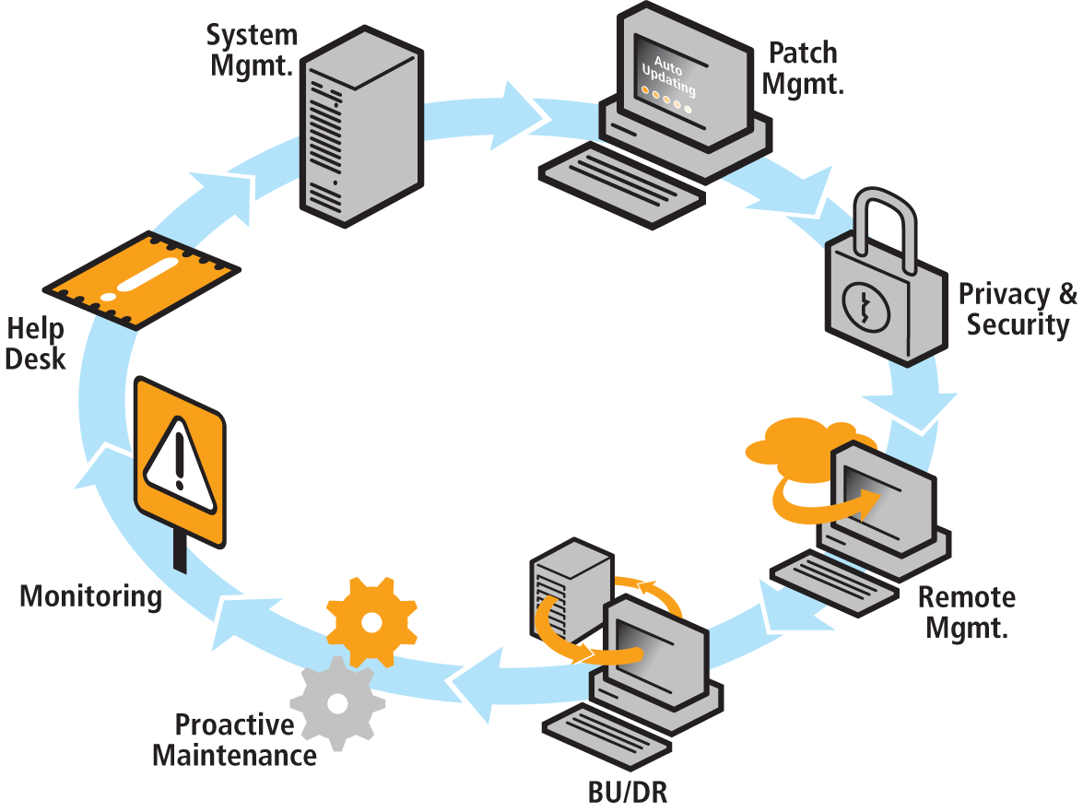
What Kaseya’s Framework Provides
Seamless and Consistent Integration Customizable Reporting
24x7x365 Automated System Management
Patch Management and Updates
Monitoring
Remote Management
Application Deployment
Asset Management
Ticketing, / Service Desk
Data Protection,
Privacy – Anti-Spy,
Anti-Virus
User State Management
More….
Notes:
68

Slide 69
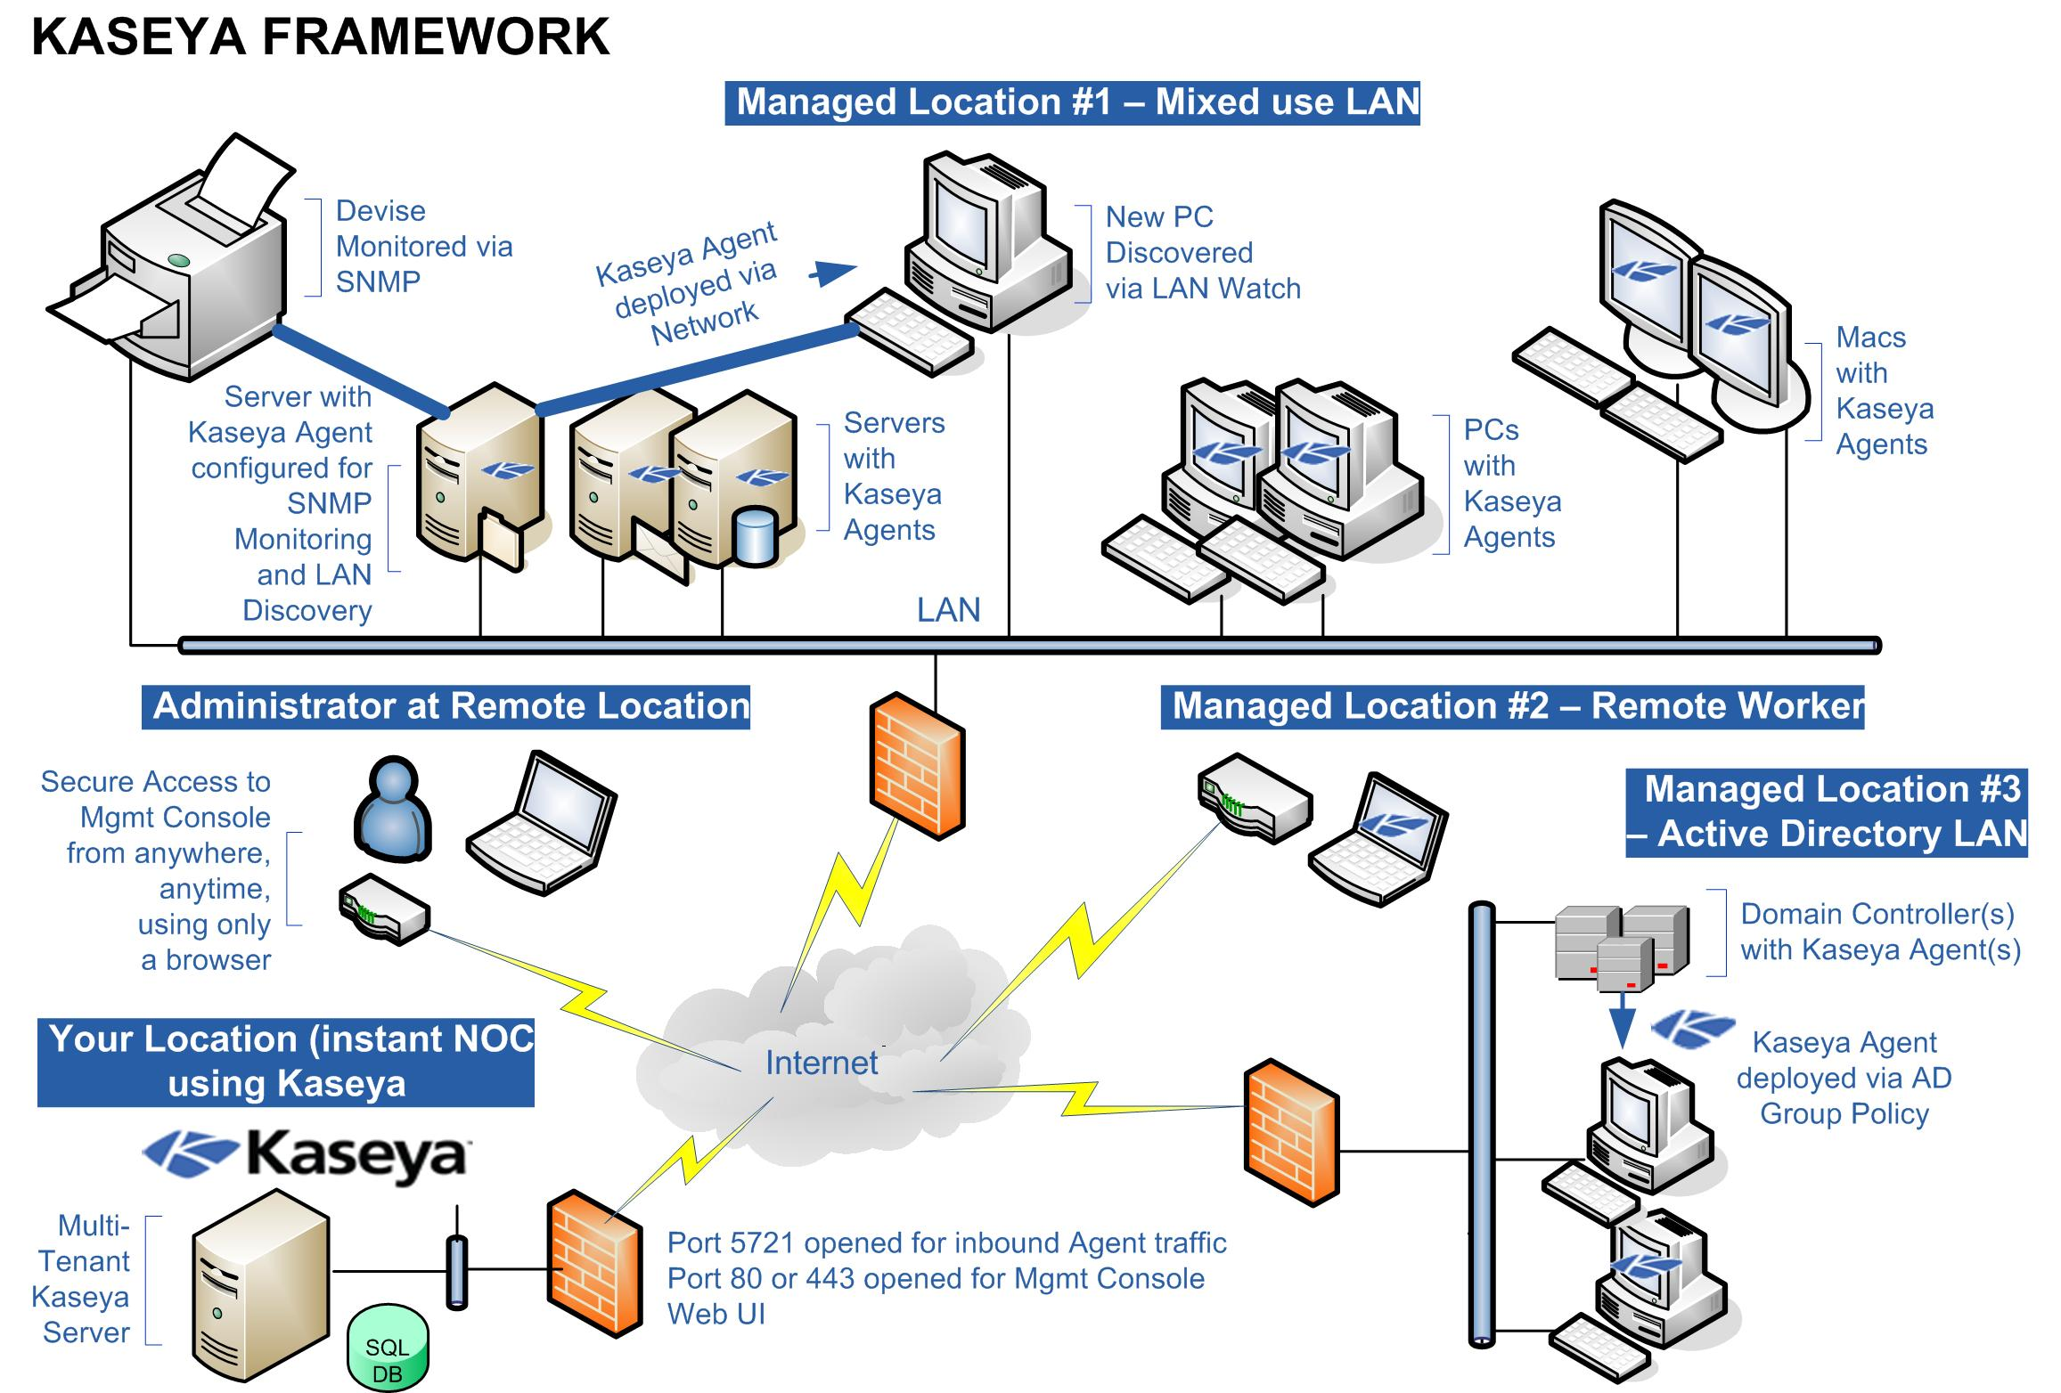
Flexible Deployment

Slide 70
Kaseya Agent Topography Simulation
Agent Quick Check-in
Default 30 Sec
Like a Ping
Agent Full Check-in
When Task is scheduled
Instructing the agent to do something
Agent Alive
Tasks
When Task is scheduled the Agent Grabs the task and executes without needing firewall ports open

Slide 71
Agenda
Background
Defining Managed Services
New Trends
IT Automation Tools
Summary

Slide 72
Thesis Statement
There is no single desktop delivery solution or technology that will EVER work for 100% of users. The future will see a blend of some local desktops and some remote, some shared and some single instance, some local apps and some streamed, some online and some offline. The "holy grail" is not a single technology that can be used for all, but a single product (or suite) that's INTEGRATED that lets all of these various technologies work together to truly provide any app, to any device, over any connection. But that is still a dream at this point.

Slide 73
Acknowledgements
Kaseya Staff
Especial thanks to Charles Spencer, Mike DeArmond, Tim McCullen, Mike Hendrie, Dan Shapiro and others in the Kaseya training and support team.
Erick Simpson, CIO of Intelligent Enterprise, MSP University
The Guide to a Successful Managed Services Practice
The Best I.T. Service Delivery BOOK EVER!
Joe Panettieri, Editorial Director, MSPmentor
Gartner
IDC
The TechRepublic Webcasts Staff
Autotask Staff

