Slide 1
Virtual Step PIN Pad: Towards Foot-input Authentication Using Geophones
Yan He, Hanyan Zhang, Edwin Yang, Song Fang University of Oklahoma

Slide 2
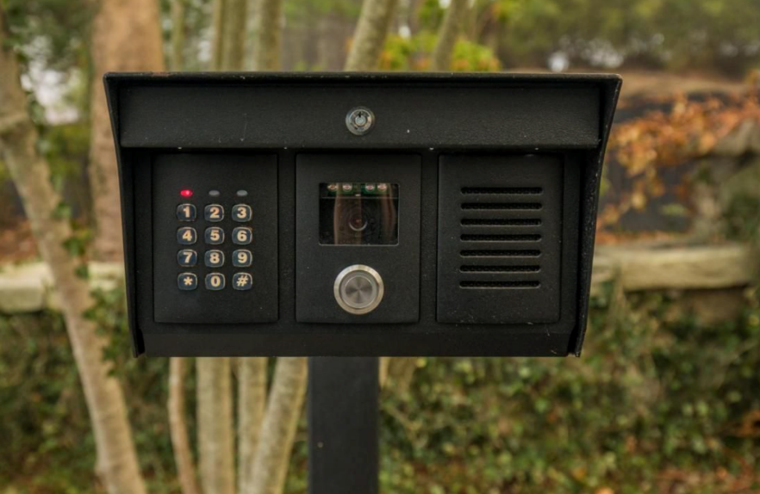
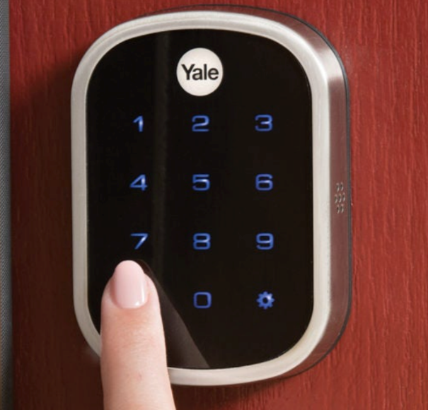
PIN Authentication
Finger-input based PIN authentication is popular
Traditional physical button based PIN pad
Touchsreen based PIN pad

Slide 3
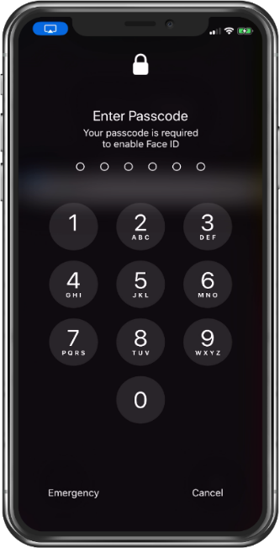


Limitation 1 – Not Work for All Users
Touchscreen does not react to a wet (sweaty) finger.
3% of the population in the US experience hyperhidrosis or excessive sweating of the palms^{[1]}
[1] A. Haider and N. Solish, “Focal hyperhidrosis: diagnosis and management,” Canadian Medical Association Journal (CMAJ), vol. 172, no. 1, pp. 69–75, 2005.

Slide 4

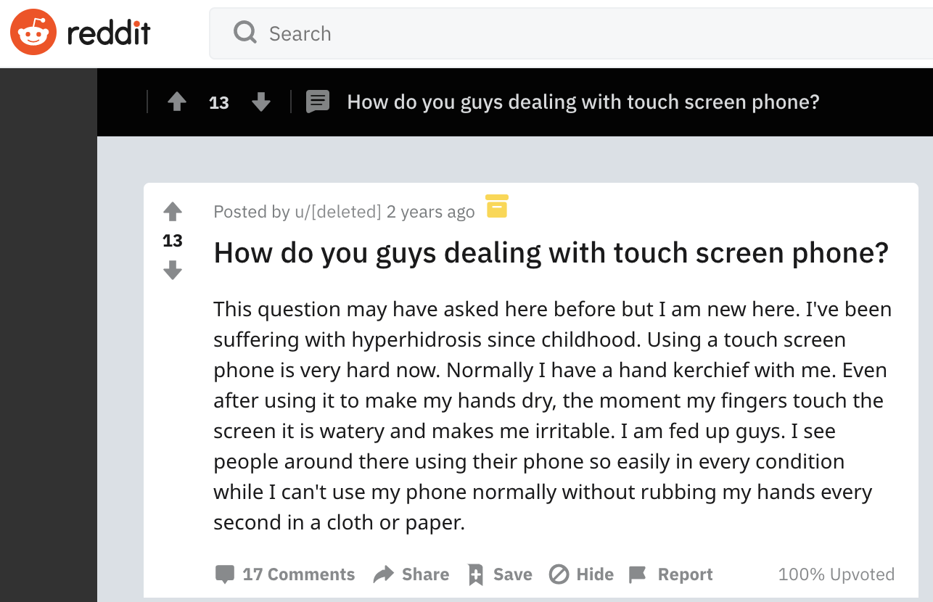


Slide 5
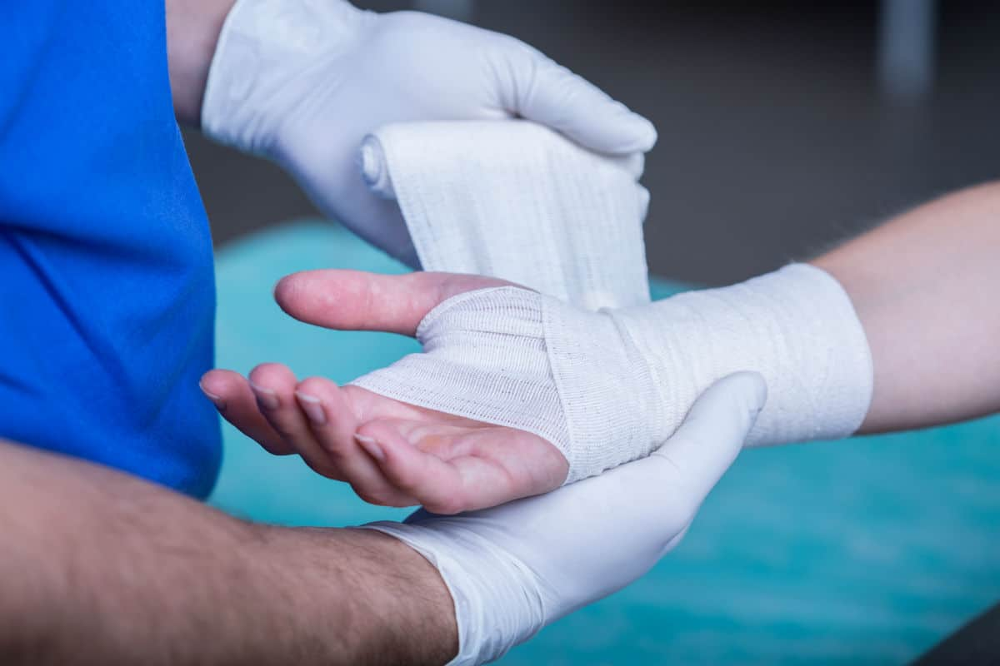
Limitation 1 (Cont’d)
Users with hand or finger injuries cannot use them.
There are 45,000 amputations annually due to traumatic injuries to the hands and fingers in the US^{[2]}
[2] D. B. Reid, K. N. Shah, A. E. Eltorai, C. C. Got, and A. H. Daniels, “Epidemiology of finger amputations in the united states from 1997 to 2016,” Journal of Hand Surgery Global Online, vol. 1, no. 2, pp. 45 – 51, 2019.

Slide 6



Limitation 2 – Bring Privacy Concerns
Touches with finger may disclose fingerprint
Touch-screen PIN entry systems may suffer from smudge attacks, i.e., an attacker extracts sensitive information about recent user input using smudges (oily residues)
Develop a scheme that (1) works for people including who cannot use fingers for typing; and (2) mitigates privacy disclosure risks

Slide 7

What About Biometric Authentication?
Expensive: dedicated user interface + a database for all users
Consequence is serious if sensitive biometric information is disclosed

Slide 8

What About Using Eye Gaze?
Correlate the position of user’s gaze on screen to a digit input
Pre-deploy an on-screen keyboard before PIN input
Require a camera to monitor the user’s eye movement

Slide 9
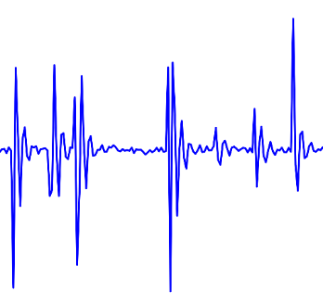
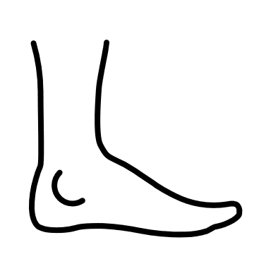
What Else?
Foot tapping: raising and lowering the toes or heel
How to convert foot taps into digits?
Geophone
Distinguish different foot taps (digits)

Slide 10
Outline
Background ✓
  Existing authentication schemes & limitations
  Our solution
System Design
Evaluation
Conclusion

Slide 11



An Example of Virtual Step PIN Pad
2
3
5
PIN: 9532
9
(PIN: 9532)

Slide 12
Challenges
How to activate the virtual step PIN pad and determine the start point of PIN input?
How to reduce noise in raw geophone signals and segment geophone signals generated by PIN input?
How to demodulate the input digits using collected geophone signals?
How to guarantee the security of PIN, especially considering advanced attacks?

Slide 13
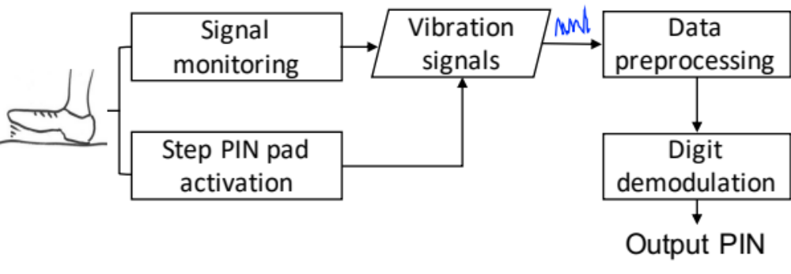
System Overview
Basic idea: achieve PIN recognition by analyzing location-dependent features from structural vibration signals caused by foot tapping
Virtual Step PIN Pad Schematic

Slide 14
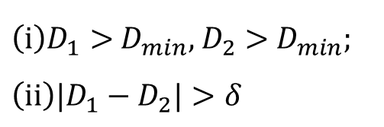
First Challenge – Activation
No physical PIN pad
Functions of the activation signal:
Notify the system to start PIN authentication afterwards
Achieve an agreement about the virtual PIN pad location between the user and the system
G₃
1 | 2 | 3
4 | 5 | 6
7 | 8 | 9
minimum interval distance
D₁
$\left(i\right)D_{1}>$ $D_{min},$ $D_{2}>$ $D_{min};$ ${\left(ii\right)|D}_{1}−D_{2}|>δ$
G₂
D₂
G₁
pre-determined threshold

Slide 15
Second Challenge – Data Preprocessing
Noise reduction
Fast Fourier Transform (FFT) filtering
Structural vibration signal segmentation
Cross-correlation: quantify the similarity of two waveforms
Two steps:
  1. Identify inter-vibration intervals;
  2. Separate foot tapping with inferences (e.g., dropping an object to the ground)
· · ·
Non-vibration
· · ·
· · ·
· · ·
Foot taps
Vibration
· · ·
Interference

Slide 16
Third Challenge – Digit Demodulation
Convert foot taps to corresponding digits
Observation: when we tap at different locations, the time interval between the first two local maximum amplitudes in the observed waveform (i.e., inter-peak interval) varies
1 | 2 | 3
4 | 5 | 6
7 | 8 | 9
Subarea: associate with an inter-peak interval vector
Gap area: help to perceive neighboring key areas
By comparing inter-peak intervals, the tap location (input digit) can be then determined.

Slide 17
Fourth Challenge – PIN is Disclosed
Knowledgeable observer attacks: an attacker directly observes the legitimate user’s foot movement via peeping or videotaping → Infer the PIN
Defense:
Is PIN correct?
Profiling
No
Yes
User-specific feature
Feature Extraction
SVM
No
Rejected
Matching?
Yes
Authenticated

Slide 18
Outline
Background ✓
  Existing authentication schemes & limitations
  Our solution
System Design ✓
Evaluation
Conclusion

Slide 19
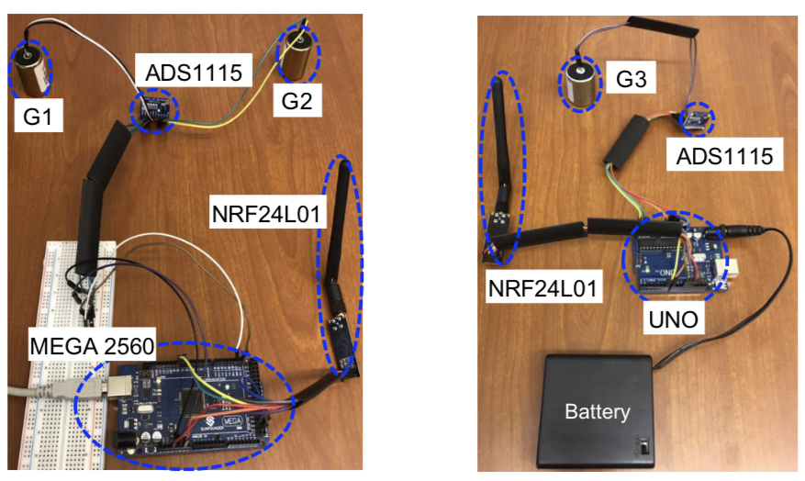
Experimental Setup
Three SM-24 geophones: G1-G3
ADS1115: 16-bit analog-to-digital converter (ADC)
Floor materials: wood, ceramic tile, and carpet
Two controllers: A and B
NRF24L01: 2.4G wireless transceiver for synchronizing data on both controllers
15 volunteers
Controller A
Controller B

Slide 20
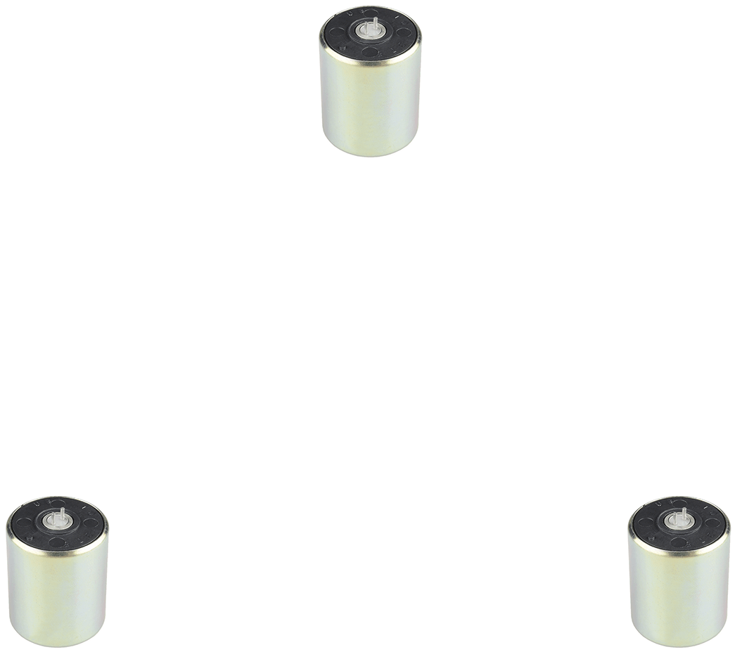






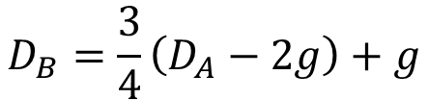
Deployment of Geophones
$$g$$
G₃
$$D_{B}=\frac{3}{4}\left(D_{A}−2g\right)+g$$
1
2
$$D_{B}$$
3
$$g$$
$g=4$ cm
G₁
G₂
4
5
$$D_{A}$$
6
Gap area width
7
8
9

Slide 21
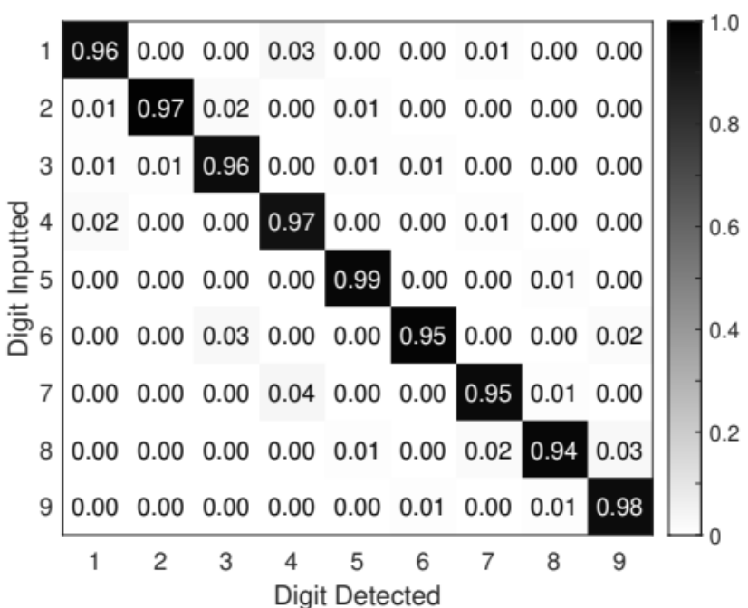
Verification Accuracy
Digit success rate: the rate of successfully recognizing a single digit

Slide 22
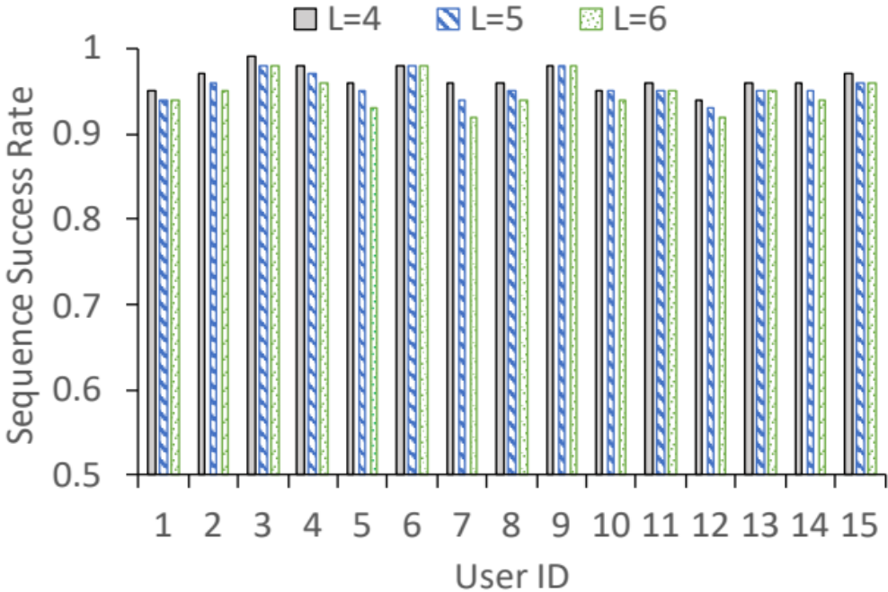
Verification Accuracy (Cont’d)
Sequence success rate: the ratio between the number of successful digit sequence identification times and the total number of digit sequence entry trials
The virtual step PIN pad authentication scheme can retain high accuracy across different users.

Slide 23
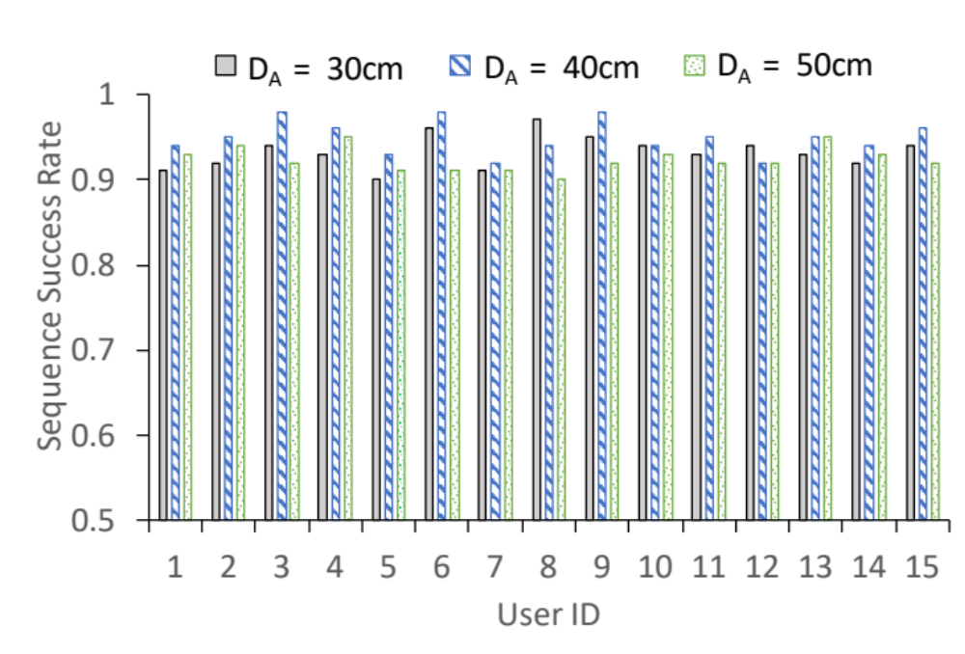
Impact of Inter-Geophone Distance
Sequence success rates for different users to input 6-digit PINs across three inter-geophone distances
The average 6-digit sequence success rates across all users when D_{A} equals to 30, 40 and 50 cm are 93.2%, 94.9%, and 93.0%, respectively.

Slide 24
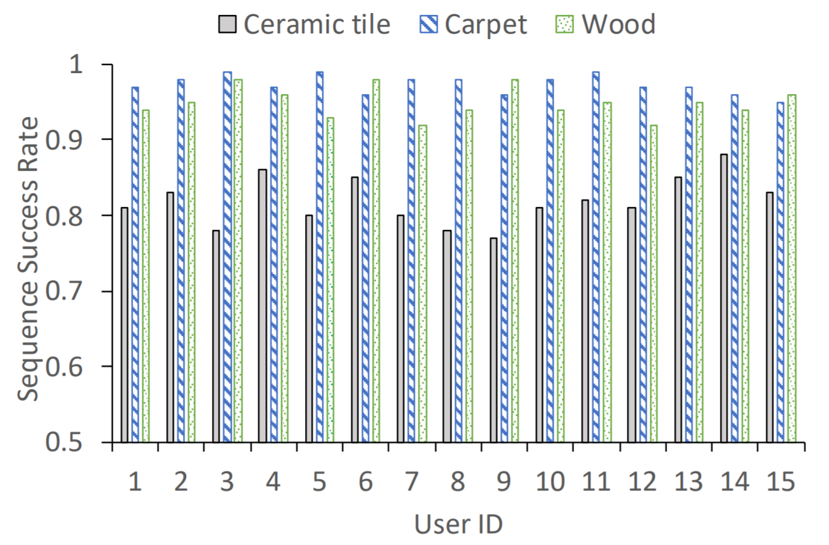
Impact of Floor Material
Sequence success rates for different users to input 6-digit PINs across three floor materials
For both carpet and wood, the sequence success rate is consistently high (in a range of 93% to 99%).

Slide 25
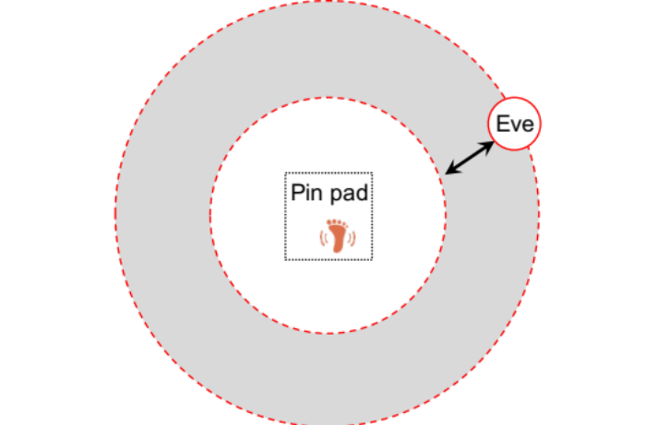
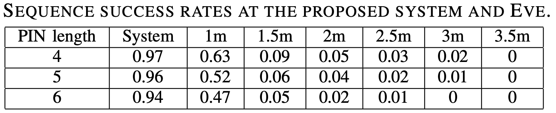
Attack Scenarios
Side-channel attack: An adversary deploys a three-geophone-based system on the ground around the PIN pad

Slide 26
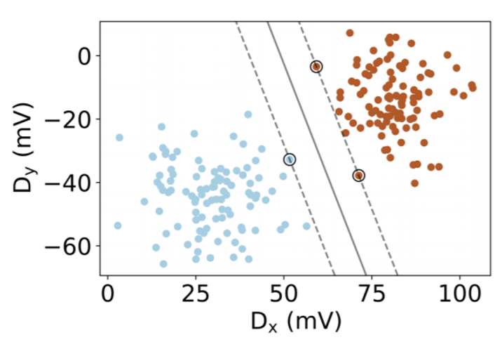
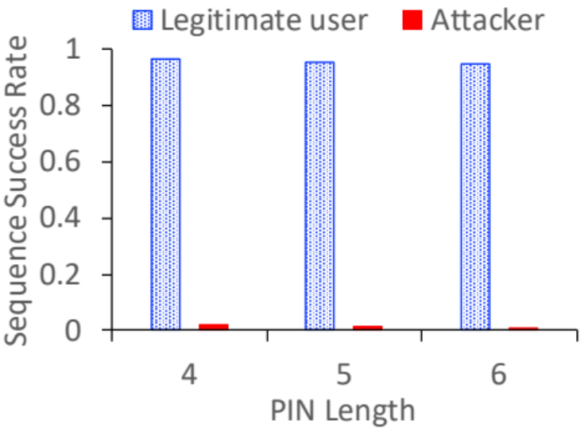
Attack Scenarios (Cont’d)
Knowledgeable observer attack:
Use SVM to detect legitimate user
Legitimate user
Mean sequence success rates:
Attacker
Running 200 foot taps on SVM
Effectiveness against knowledgeable observer attacks is verified

Slide 27
Outline
Background ✓
  Existing authentication schemes & limitations
  Our solution
System Design ✓
Evaluation ✓
Conclusion

Slide 28
Conclusion
We proposed the virtual step PIN pad technique, mapping a sequence of foot taps into a PIN with the observed structural vibration signals.
We developed the prototype of the proposed virtual step PIN pad and performed extensive experiments to validate its effectiveness and security.

Slide 29

Thank you!
Any questions?

