Slide 1

Chapter 13 – Recursion

Slide 2
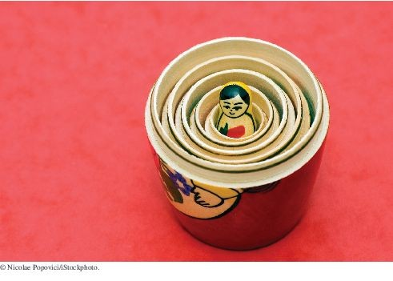
Chapter Goals
To learn to “think recursively”
To be able to use recursive helper methods
To understand the relationship between recursion and iteration
To understand when the use of recursion affects the efficiency of an algorithm
To analyze problems that are much easier to solve by recursion than by iteration
To process data with recursive structures using mutual recursion

Slide 3
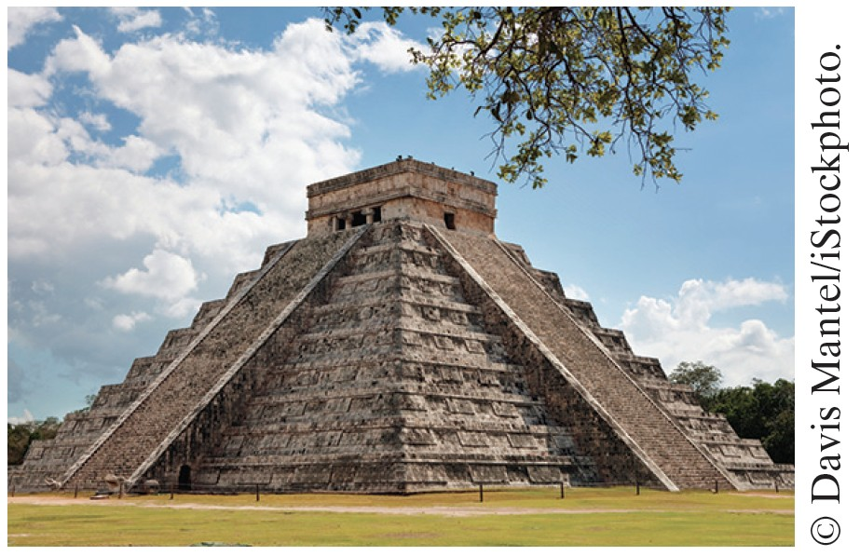
Triangle Numbers
Recursion: the same computation occurs repeatedly.
Using the same method as the one in this section, you can compute the volume of a Mayan pyramid.
Problem: to compute the area of a triangle of width n
Assume each [] square has an area of 1

Slide 4
Also called the n^{th} triangle number
The third triangle number is 6
[] [][] [][][]

Slide 5
Outline of Triangle Class
public class Triangle
{
private int width;
public Triangle(int aWidth)
{
width = aWidth;
}
public int getArea()
{
. . .
}
}

Slide 6
Handling Triangle of Width 1
The triangle consists of a single square. Its area is 1.
Add the code to getArea method for width 1:
public int getArea()
{
if (width == 1) { return 1; }
. . .
}

Slide 7
Handling the General Case
Assume we know the area of the smaller, colored triangle:
Area of larger triangle can be calculated as:
smallerArea + width
To get the area of the smaller triangle:
Make a smaller triangle and ask it for its area:
[] [][] [][][]
[][][][]
Triangle smallerTriangle = new Triangle(width - 1); int smallerArea = smallerTriangle.getArea();

Slide 8
Completed getArea Method
public int getArea()
{
if (width == 1) { return 1; }
Triangle smallerTriangle = new Triangle(width - 1); int smallerArea = smallerTriangle.getArea();
return smallerArea + width;
}
A recursive computation solves a problem by using the solution to the same problem with simpler inputs.

Slide 9
Computing the area of a triangle with width 4
getArea method makes a smaller triangle of width 3
It calls getArea on that triangle
That method makes a smaller triangle of width 2 It calls getArea on that triangle
That method makes a smaller triangle of width 1 It calls getArea on that triangle
That method returns 1
The method returns smallerArea + width = 1 + 2 = 3
The method returns smallerArea + width = 3 + 3
= 6
The method returns smallerArea + width = 6 + 4 = 10

Slide 10
Recursion
A recursive computation solves a problem by using the solution of the same problem with simpler values.
Two key requirements for successful recursion:
Every recursive call must simplify the computation in some way
There must be special cases to handle the simplest computations directly
To complete our Triangle example, we must handle width <= 0:
if (width <= 0) return 0;

Slide 11
Other Ways to Compute Triangle Numbers
The area of a triangle equals the sum:
1 + 2 + 3 + . . . + width
Using a simple loop:
double area = 0;
for (int i = 1; i <= width; i++) area = area + i;
Using math:
1 + 2 + . . . + n = n × (n + 1)/2
=> area = width * (width + 1) / 2

Slide 12
section_1/Triangle.java
1 /**
2 A triangular shape composed of stacked unit squares like this:
3 []
4 [][]
5 [][][]
6 . . .
7 */
8 public class Triangle

Slide 13
section_1/TriangleTester.java
1 public class TriangleTester
2 {
3 public static void main(String[] args)
4 {
Triangle t = new Triangle(10);
int area = t.getArea();
System.out.println("Area: " + area);
System.out.println("Expected: 55");
9 }
Program Run:
Area: 55
Expected: 55

Slide 14
Self Check 13.1
Why is the statement else if (width == 1) { return 1; }
in the getArea method unnecessary?
Answer: Suppose we omit the statement. When computing the area of a triangle with width 1, we compute the area of the triangle with width 0 as 0, and then add 1, to arrive at the correct area.

Slide 15

Self Check 13.2
How would you modify the program to recursively compute the area of a square?
Answer: You would compute the smaller area recursively, then return
smallerArea + width + width - 1.
[][][][]
[][][][]
[][][][]
[][][][]
Of course, it would be simpler to compute the area simply as width * width. The results are identical because

Slide 16
Self Check 13.3
In some cultures, numbers containing the digit 8 are lucky numbers. What is wrong with the following method that tries to test whether a number is lucky?
public static boolean isLucky(int number)
{
int lastDigit = number % 10;
if (lastDigit == 8) { return true; } else
{
return isLucky(number / 10); // Test the number without the last digit
}
}
Answer: There is no provision for stopping the recursion. When a number < 10 isn’t 8, then the method should return false and stop.

Slide 17
Self Check 13.4
In order to compute a power of two, you can take the next-lower power and double it. For example, if you want to compute 2¹¹ and
you know that 2¹⁰ = 1024, then 2¹¹ = 2 × 1024 = 2048. Write a recursive method public static int pow2(int n) that is based on this observation.
Answer:
public static int pow2(int n)
{
if (n <= 0) { return 1; } // 20 is 1 else { return 2 * pow2(n - 1); }
}

Slide 18
Self Check 13.5
Consider the following recursive method:
public static int mystery(int n)
{
if (n <= 0) { return 0; } else
{
int smaller = n - 1;
return mystery(smaller) + n * n;
}
}
What is mystery(4)?
Answer:
mystery(4) calls mystery(3) mystery(3) calls mystery(2)
mystery(2) calls mystery(1) mystery(1) calls mystery(0)
mystery(0) returns 0.
mystery(1) returns 0 + 1 * 1 = 1
mystery(2) returns 1 + 2 * 2 = 5
mystery(3) returns 5 + 3 * 3 = 14
mystery(4) returns 14 + 4 * 4 = 30

Slide 19
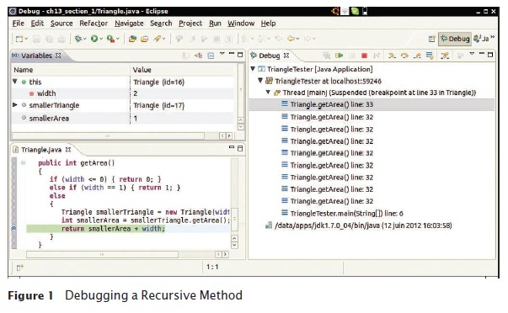
Tracing Through Recursive Methods
To debug recursive methods with a debugger, you need to be particularly careful, and watch the call stack to understand which nested call you currently are in.cc

Slide 20

Thinking Recursively
Thinking recursively is easy if you can recognize a subtask that is similar to the original task.
Problem: test whether a sentence is a palindrome
Palindrome: a string that is equal to itself when you reverse all characters
  A man, a plan, a canal – Panama!
  Go hang a salami, I'm a lasagna hog
  Madam, I'm Adam

Slide 21
Implement isPalindrome
Method: How To 13.1
public class Sentence
{
private String text;
/**
Constructs a sentence.
@param aText a string containing all characters of the sentence
*/
public Sentence(String aText)
{
text = aText;
}
/**
Tests whether this sentence is a palindrome.
@return true if this sentence is a palindrome, false otherwise
*/
public boolean isPalindrome()
{
. . .
}
}

Slide 22
Thinking Recursively: How To 13.1
1. Consider various ways to simplify inputs. Here are several possibilities:
Remove the first character. Remove the last character.
Remove both the first and last characters. Remove a character from the middle.
Cut the string into two halves.

Slide 23
Thinking Recursively: How To 13.1
2. Combine solutions with simpler inputs into a solution of the original problem.
Most promising simplification: Remove first and last characters
adam, I'm Ada, is a palindrome too!
Thus, a word is a palindrome if
  The first and last letters match, and
  Word obtained by removing the first and last letters is a palindrome
What if first or last character is not a letter? Ignore it.
  If the first and last characters are letters, check whether they match;
  if so, remove both and test shorter string
  If last character isn't a letter, remove it and test shorter string
  If first character isn't a letter, remove it and test shorter string

Slide 24
Thinking Recursively: How To 13.1
3. Find solutions to the simplest inputs.
Strings with two characters
No special case required; step two still applies
Strings with a single character
They are palindromes
The empty string
It is a palindrome

Slide 25
Thinking Recursively: How To 13.1
4. Implement the solution by combining the simple cases and the reduction step:
public boolean isPalindrome()
{
int length = text.length();
// Separate case for shortest strings. if (length <= 1) { return true; }
// Get first and last characters, converted to lowercase. char first = Character.toLowerCase(text.charAt(0));
char last = Character.toLowerCase(text.charAt(length - 1)); if (Character.isLetter(first) && Character.isLetter(last))
{
// Both are letters. if (first == last)
{
// Remove both first and last character.
Sentence shorter = new Sentence(text.substring(1, length - 1)); return shorter.isPalindrome();
}
else
{
return false;
}
}
else if (!Character.isLetter(last))
{
// Remove last character.

Slide 26
Sentence shorter = new Sentence(text.substring(0, length - 1)); return shorter.isPalindrome();
}
else
{
// Remove first character.
Sentence shorter = new Sentence(text.substring(1)); return shorter.isPalindrome();
}
}

Slide 27

Recursive Helper Methods
Sometimes, a task can be solved by handing it off to a recursive helper method.
Sometimes it is easier to find a recursive solution if you make a slight change to the original problem.
Consider the palindrome test of previous slide.
  It is a bit inefficient to construct new Sentence objects in every step
Rather than testing whether the sentence is a palindrome, check whether a substring is a palindrome:
/**
Tests whether a substring of the sentence is a palindrome.
@param start the index of the first character of the substring
@param end the index of the last character of the substring
@return true if the substring is a palindrome
*/
public boolean isPalindrome(int start, int end)

Slide 28
Recursive Helper Methods:
isPalindrome
public boolean isPalindrome(int start, int end)
{
// Separate case for substrings of length 0 and 1. if (start >= end) { return true; }
// Get first and last characters, converted to lowercase. char first = Character.toLowerCase(text.charAt(start)); char last = Character.toLowerCase(text.charAt(end));
if (Character.isLetter(first) && Character.isLetter(last))
{
if (first == last)
{
// Test substring that doesn’t contain the matching letters. return isPalindrome(start + 1, end - 1);
}
else
{
return false;
}
}
else if (!Character.isLetter(last))
{
// Test substring that doesn’t contain the last character. return isPalindrome(start, end - 1);
}
else
{
// Test substring that doesn’t contain the first character. return isPalindrome(start + 1, end);
}
}

Slide 29
Recursive Helper Methods
Provide a method to call the helper method with positions that test the entire string:
public boolean isPalindrome()
{
return isPalindrome(0, text.length() - 1);
}
This call is not recursive
The isPalindrome(String) method calls the helper method isPalindrome(String, int, int).
An example of overloading
The public will call isPalindrome(String)
method.
isPalindrome(String, int, int) is the recursive helper method.

Slide 30
Self Check 13.6
Do we have to give the same name to both isPalindrome
methods?
Answer: No — the second one could be given a different name such as substringIsPalindrome.

Slide 31
Self Check 13.7
When does the recursive isPalindrome method stop calling itself?
Answer: When start >= end, that is, when the investigated string is either empty or has length 1.

Slide 32
Self Check 13.8
To compute the sum of the values in an array, add the first value to the sum of the remaining values, computing recursively. Of course, it would be inefficient to set up an actual array of the remaining values. Which recursive helper method can solve the problem?
Answer: A sumHelper(int[] a, int start, int size). The method calls sumHelper(a, start + 1, size).

Slide 33
Self Check 13.9
How can you write a recursive method public static void sum(int[] a) without needing a helper function?
Answer: Call sum(a, size - 1) and add the last element, a[size - 1].

Slide 34
The Efficiency of Recursion: Fibonacci Sequence
Fibonacci sequence is a sequence of numbers defined by:
f₁ = 1
f₂ = 1
^{f}n ^{= f}n-1 ^{+ f}n-2
First ten terms:
1, 1, 2, 3, 5, 8, 13, 21, 34, 55

Slide 35
section_3/RecursiveFib.java
1 import java.util.Scanner;
2
3 /**
4 This program computes Fibonacci numbers using a recursive method.
5 */
6 public class RecursiveFib
7 {
8 public static void main(String[] args)
9 {
Program Run:
Enter n: 50
fib(1) = 1
fib(2) = 1
fib(3) = 2
fib(4) = 3
fib(5) = 5
fib(6) = 8
fib(7) = 13
. . .
fib(50) = 12586269025

Slide 36
The Efficiency of Recursion
Recursive implementation of fib is straightforward.
Watch the output closely as you run the test program.
First few calls to fib are quite fast.
For larger values, the program pauses an amazingly long time between outputs.
To find out the problem, lets insert trace messages.

Slide 37
section_3/RecursiveFibTracer.java
1 import java.util.Scanner;
2
3 /**
This program prints trace messages that show how often the
recursive method for computing Fibonacci numbers calls itself.
6 */
7 public class RecursiveFibTracer
8 {
9 public static void main(String[] args)
Program Run:
Enter n: 6
Entering fib: n = 6 Entering fib: n = 5 Entering fib: n = 4 Entering fib: n = 3 Entering fib: n = 2
Exiting fib: n = 2 return value = 1 Entering fib: n = 1
Exiting fib: n = 1 return value = 1 Exiting fib: n = 3 return value = 2 Entering fib: n = 2
Exiting fib: n = 2 return value = 1 Exiting fib: n = 4 return value = 3 Entering fib: n = 3

Slide 38
Entering fib: n = 2
Exiting fib: n = 2 return value = 1 Entering fib: n = 1
Exiting fib: n = 1 return value = 1 Exiting fib: n = 3 return value = 2 Exiting fib: n = 5 return value = 5 Entering fib: n = 4
Entering fib: n = 3 Entering fib: n = 2
Exiting fib: n = 2 return value = 1 Entering fib: n = 1
Exiting fib: n = 1 return value = 1 Exiting fib: n = 3 return value = 2 Entering fib: n = 2
Exiting fib: n = 2 return value = 1 Exiting fib: n = 4 return value = 3 Exiting fib: n = 6 return value = 8 fib(6) = 8

Slide 39
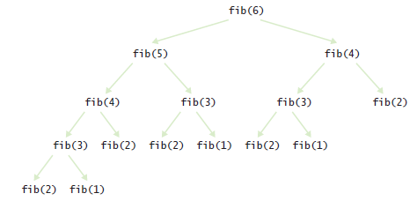
Call Tree for Computing
fib(6)
Figure 2 Call Pattern of the Recursive fib Method

Slide 40
The Efficiency of Recursion
Method takes so long because it computes the same values over and over.
The computation of fib(6) calls fib(3) three times.
Imitate the pencil-and-paper process to avoid computing the values more than once.

Slide 41
section_3/LoopFib.java
1 import java.util.Scanner;
2
3 /**
4 This program computes Fibonacci numbers using an iterative method.
5 */
6 public class LoopFib
7 {
8 public static void main(String[] args)
9 {
Program Run:
Enter n: 50
fib(1) = 1
fib(2) = 1
fib(3) = 2
fib(4) = 3
fib(5) = 5
fib(6) = 8
fib(7) = 13
. . .
fib(50) = 12586269025

Slide 42

The Efficiency of Recursion
In most cases, the iterative and recursive approaches have comparable efficiency.
Occasionally, a recursive solution runs much slower than its iterative counterpart.
In most cases, the recursive solution is only slightly slower.
The iterative isPalindrome performs only slightly better than recursive solution.
  Each recursive method call takes a certain amount of processor time
Smart compilers can avoid recursive method calls if they follow simple patterns.
Most compilers don't do that.
In many cases, a recursive solution is easier to understand and implement correctly than an iterative solution.

Slide 43
Iterative is Palindrome
Method
public boolean isPalindrome()
{
int start = 0;
int end = text.length() - 1; while (start < end)
{
char first = Character.toLowerCase(text.charAt(start)); char last = Character.toLowerCase(text.charAt(end);
if (Character.isLetter(first) && Character.isLetter(last))
{
// Both are letters. if (first == last)
{
start++; end--;
}
else
{
return false;
}
}
if (!Character.isLetter(last)) { end--; }
if (!Character.isLetter(first)) { start++; }
}
return true;
}

Slide 44
Self Check 13.10
Is it faster to compute the triangle numbers recursively, as shown in Section 13.1, or is it faster to use a loop that computes 1 + 2 + 3
+ . . . + width?
Answer: The loop is slightly faster. Of course, it is even faster to simply compute width * (width
+ 1) / 2.

Slide 45
Self Check 13.11
You can compute the factorial function either with a loop, using the definition that n! = 1 × 2 × . . . × n, or recursively, using the definition that 0! = 1 and n! = (n – 1)! × n. Is the recursive approach inefficient in this case?
Answer: No, the recursive solution is about as efficient as the iterative approach. Both require n – 1 multiplications to compute n!.

Slide 46
Self Check 13.12
To compute the sum of the values in an array, you can split the array in the middle, recursively compute the sums of the halves, and add the results. Compare the performance of this algorithm with that of a loop that adds the values.
Answer: The recursive algorithm performs about as well as the loop. Unlike the recursive Fibonacci algorithm, this algorithm doesn’t call itself again on the same input. For example, the sum of the array 1 4 9 16 25 36 49 64 is computed as the sum of 1
4 9 16 and 25 36 49 64, then as the sums of 1 4, 9
16, 25 36, and 49 64, which can be computed directly.

Slide 47

Permutations
Using recursion, you can find all arrangements of a set of objects.
Design a class that will list all permutations of a string.
A permutation is a rearrangement of the letters.
The string "eat" has six permutations:
"eat"
"eta"
"aet"
"ate"
"tea"
"tae"

Slide 48
Permutations
Problem: Generate all the permutations of "eat".
First generate all permutations that start with the letter 'e', then 'a' then 't'.
How do we generate the permutations that start with 'e'?
We need to know the permutations of the substring "at". But that’s the same problem—to generate all permutations— with a simpler input
Prepend the letter 'e' to all the permutations you found of 'at'.
Do the same for 'a' and 't'.
Provide a special case for the simplest strings.
  The simplest string is the empty string, which has a single permutation—itself.

Slide 49
section_4/Permutations.java
1 import java.util.ArrayList;
2
3 /**
4 This program computes permutations of a string.
5 */
6 public class Permutations
7 {
8 public static void main(String[] args)
9 {
Program Run:
eat eta aet ate tea tae

Slide 50
Self Check 13.13
What are all permutations of the four-letter word beat?
Answer: They are b followed by the six permutations of eat, e followed by the six permutations of bat, a followed by the six permutations of bet, and t followed by the six permutations of bea.

Slide 51
Self Check 13.14
Our recursion for the permutation generator stops at the empty string. What simple modification would make the recursion stop at strings of length 0 or 1?
Answer: Simply change if (word.length()
== 0) to if (word.length() <= 1), because a word with a single letter is also its sole permutation.

Slide 52
Self Check 13.15
Why isn’t it easy to develop an iterative solution for the permutation generator?
Answer: An iterative solution would have a loop whose body computes the next permutation from the previous ones. But there is no obvious mechanism for getting the next permutation. For example, if you already found permutations eat, eta, and aet, it is not clear how you use that information to get the next permutation. Actually, there is an ingenious mechanism for doing just that, but it is far from obvious —see Exercise P13.12.

Slide 53
Mutual Recursions
Problem: to compute the value of arithmetic expressions such as:
3 + 4 * 5
(3 + 4) * 5
1 - (2 - (3 - (4 - 5)))
Computing expression is complicated
* and / bind more strongly than + and -
Parentheses can be used to group subexpressions

Slide 54
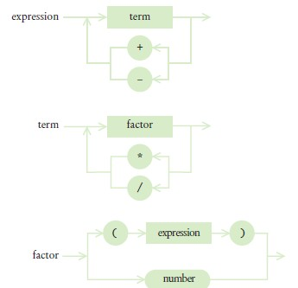
Syntax Diagrams for Evaluating an Expression
Figure 3

Slide 55
Mutual Recursions
An expression can broken down into a sequence of terms, separated by + or - .
Each term is broken down into a sequence of factors, separated by * or / .
Each factor is either a parenthesized expression or a number.
The syntax trees represent which operations should be carried out first.

Slide 56
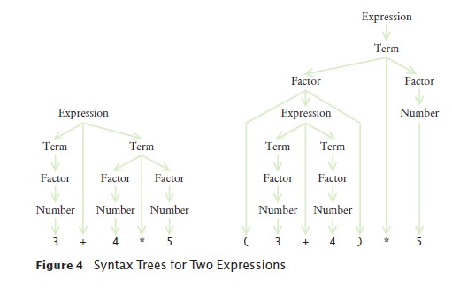
Syntax Tree for Two Expressions

Slide 57
Mutually Recursive Methods
In a mutual recursion, a set of cooperating methods calls each other repeatedly.
To compute the value of an expression, implement 3 methods that call each other recursively:
getExpressionValue getTermValue getFactorValue

Slide 58
The getExpressionValue
Method
public int getExpressionValue()
{
int value = getTermValue(); boolean done = false;
while (!done)
{
String next = tokenizer.peekToken();
if ("+".equals(next) || "-".equals(next))
{
tokenizer.nextToken(); // Discard "+" or "-" int value2 = getTermValue();
if ("+".equals(next)) value = value + value2; else value = value - value2;
}
else
{
done = true;
}
}
return value;
}

Slide 59
The getTermValue Method
The getTermValue method calls getFactorValue in the same way, multiplying or dividing the factor values.

Slide 60
The getFactorValue Method
public int getFactorValue()
{
int value;
String next = tokenizer.peekToken(); if ("(".equals(next))
{
tokenizer.nextToken(); // Discard "(" value = getExpressionValue(); tokenizer.nextToken(); // Discard ")"
}
else
{
value = Integer.parseInt(tokenizer.nextToken());
}
return value;
}

Slide 61
Using Mutual Recursions
To see the mutual recursion clearly, trace through the expression
(3+4)*5:
getExpressionValue calls getTermValue
getTermValue calls getFactorValue
getFactorValue consumes the ( input
getFactorValue calls getExpressionValue
getExpressionValue returns eventually with the value of 7, having consumed 3 + 4. This is the recursive call.
getFactorValue consumes the ) input
getFactorValue returns 7
getTermValue consumes the inputs * and 5 and returns 35
getExpressionValue returns 35
Recursion terminates when all the tokens of the input string are consumed.

Slide 62
section_5/Evaluator.java
1 /**
2 A class that can compute the value of an arithmetic expression.
3 */
4 public class Evaluator
5 {
6 private ExpressionTokenizer tokenizer;
7
8
9
/**
Constructs an evaluator.

Slide 63
section_5/ExpressionTokenizer.java
1 /**
This class breaks up a string describing an expression
into tokens: numbers, parentheses, and operators.
4 */
5 public class ExpressionTokenizer
6 {
private String input;
private int start; // The start of the current token
private int end; // The position after the end of the current token

Slide 64
section5/ExpressionCalculator.java
1 import java.util.Scanner;
2
3 /**
This program calculates the value of an expression
consisting of numbers, arithmetic operators, and parentheses.
6 */
7 public class ExpressionCalculator
8 {
9 public static void main(String[] args)
Program Run:
Enter an expression: 3+4*5 3+4*5=23

Slide 65
Self Check 13.16
What is the difference between a term and a factor? Why do we need both concepts?
Answer: Factors are combined by multiplicative operators (* and /), terms are combined by additive operators (+, -). We need both so that multiplication can bind more strongly than addition.

Slide 66
Self Check 13.17
Why does the expression parser use mutual recursion?
Answer: To handle parenthesized expressions, such as 2 + 3*(4 + 5). The subexpression 4 + 5 is handled by a recursive call to getExpressionValue.

Slide 67
Self Check 13.18
What happens if you try to parse the illegal expression 3+4*)5? Specifically, which method throws an exception?
Answer: The Integer.parseInt call in getFactorValue throws an exception when it is given the string ")".

Slide 68
Backtracking
Backtracking is a problem solving technique that builds up partial solutions that get increasingly closer to the goal.
If a partial solution cannot be completed, one abandons it And returns to examining the other candidates.
Characteristic properties needed to use backtracking for a problem.
1. A procedure to examine a partial solution and determine whether to
Accept it as an actual solution.
Abandon it (either because it violates some rules or because it is clear that it can never lead to a valid solution).
Continue extending it.

Slide 69

2. A procedure to extend a partial solution, generating one or more solutions that come closer to the goal.
In a backtracking algorithm, one explores all paths towards a solution. When one path is a dead end, one needs to backtrack and try another choice.

Slide 70
Backtracking
Backtracking can then be expressed with the following recursive algorithm.
Solve(partialSolution) Examine(partialSolution). If accepted
Add partialSolution to the list of solutions. Else if continuing
For each p in extend(partialSolution) Solve(p).

Slide 71
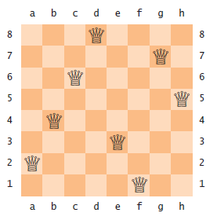
Backtracking - Eight Queens Problem
The Problem: position eight queens on a chess board so that none of them attacks another according to the rules of chess.
There are no two queens on the same row, column, or diagonal
A Solution to the Eight Queens Problem:

Slide 72
Backtracking - Eight Queens Problem
To examine a partial solution:
If two queens attack each other, reject it. Otherwise, if it has eight queens, accept it. Otherwise, continue.
To extend a partial solution:
Add another queen on an empty square
For efficiency, place first queen in row 1, the next in row 2, and so on

Slide 73
Backtracking
Provide a class PartialSolution
that collects the queens in a partial solution,
and that has methods to examine and extend the solution
public class PartialSolution
{
private Queen[] queens;
public int examine() { . . . }
public PartialSolution[] extend() { . . . }
}

Slide 74
Backtracking
The examine method simply checks whether two queens attack each other:
public int examine()
{
for (int i = 0; i < queens.length; i++)
{
for (int j = i + 1; j < queens.length; j++)
{
if (queens[i].attacks(queens[j])) { return ABANDON; }
}
}
if (queens.length == NQUEENS) { return ACCEPT; } else { return CONTINUE; }
}

Slide 75
Backtracking
The extend method takes a given solution
And makes eight copies of it.
Each copy gets a new queen in a different column.
public PartialSolution[] extend()
{
// Generate a new solution for each column PartialSolution[] result = new PartialSolution[NQUEENS]; for (int i = 0; i < result.length; i++)
{
int size = queens.length;
// The new solution has one more row than this one result[i] = new PartialSolution(size + 1);
// Copy this solution into the new one for (int j = 0; j < size; j++)
{
result[i].queens[j] = queens[j];
}
// Append the new queen into the ith column result[i].queens[size] = new Queen(size, i);
}
return result;
}

Slide 76
Backtracking
To determine if two queens attack each other diagonally
Compute the slope.
If it ±1 the queens attack each other diagonally?
Just check:
|row₂ - row₁| = |column₂ - column₁|

Slide 77
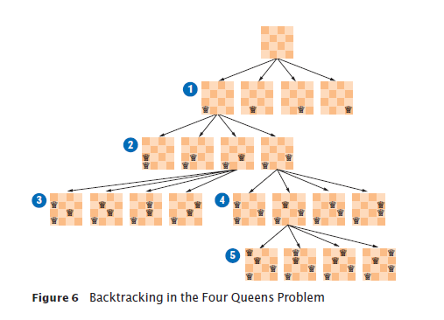
Backtracking
Backtracking in the Four Queens Problem

Slide 78
section_6/PartialSolution.java
1 import java.util.Arrays;
2
3 /**
4 A partial solution to the eight queens puzzle.
5 */
6 public class PartialSolution
7 {
private Queen[] queens;
private static final int NQUEENS = 8;
10
11
12
13
14
15
16
17
18
19
20
21
22
23
24
25
26
27
public static final int ACCEPT = 1; public static final int ABANDON = 2; public static final int CONTINUE = 3;
/**
Constructs a partial solution of a given size.
@param size the size
*/
public PartialSolution(int size)
{
queens = new Queen[size];
}
/**
Examines a partial solution.
@return one of ACCEPT, ABANDON, CONTINUE
*/

Slide 79
28
29
30
31
32
33
34
35
public int examine()
{
for (int i = 0; i < queens.length; i++)
{
for (int j = i + 1; j < queens.length; j++)
{
if (queens[i].attacks(queens[j])) { return ABANDON; }
}

Slide 80
section_6/Queen.java
1 /**
2 A queen in the eight queens problem.
3 */
4 public class Queen
5 {
private int row;
private int column;
8
9
10
11
12
13
14
15
16
17
18
19
20
21
22
23
24
25
26
/**
Constructs a queen at a given position.
@param r the row
@param c the column
*/
public Queen(int r, int c)
{
row = r; column = c;
}
/**
Checks whether this queen attacks another.
@param other the other queen
@return true if this and the other queen are in the same row, column, or diagonal.
*/
public boolean attacks(Queen other)

Slide 81
27
28
29
30
31
32
33
34
{
return row == other.row
|| column == other.column
|| Math.abs(row - other.row) == Math.abs(column - other.col
}
public String toString()
{

Slide 82
section_6/EightQueens.java
1 /**
2 This class solves the eight queens problem using backtracking.
3 */
4 public class EightQueens
5 {
6 public static void main(String[] args)
7 {
8 solve(new PartialSolution(0));
9 }
10
11
12
13
14
15
16
17
18
19
20
21
22
23
24
25
26
27
/**
Prints all solutions to the problem that can be extended from a given partial solution.
@param sol the partial solution
*/
public static void solve(PartialSolution sol)
{
int exam = sol.examine();
if (exam == PartialSolution.ACCEPT)
{
System.out.println(sol);
}
else if (exam == PartialSolution.CONTINUE)
{
for (PartialSolution p : sol.extend())
{
solve(p);

Slide 83
Program Run:
28 |  |  | }
29 |  |  | }
30 |  | }
31 | }
32
[a1, e2, h3, f4, c5, g6, b7, d8]
[a1, f2, h3, c4, g5, d6, b7, e8]
[a1, g2, d3, f4, h5, b6, e7, c8]
. . .
[f1, a2, e3, b4, h5, c6, g7, d8]
. . .
[h1, c2, a3, f4, b5, e6, g7, d8]
[h1, d2, a3, c4, f5, b6, g7, e8]
(92 solutions)

Slide 84
Self Check 13.19
Why does j begin at i + 1 in the examine method?
Answer: We want to check whether any queen[i] attacks any queen[j], but attacking is symmetric. That is, we can choose to compare only those for which i < j (or, alternatively, those for which i > j). We don’t want to call the attacks method when i equals j; it would return true.

Slide 85

Self Check 13.20
Continue tracing the four queens problem as shown in Figure 6. How many solutions are there with the first queen in position a2?
Answer: One solution:

Slide 86
Self Check 13.21
How many solutions are there altogether for the four queens problem?
Answer: Two solutions: The one from Self Check 20, and its mirror image.

